Slide 1

ISLAMIC UNIVERSITY OF TECHNOLOGY
EEE-4800
Supervisor:
Mr. Asif Newaz
Lecturer
Department of Electrical and Electronic Engineering
Islamic University of Technology
MEMBERS:
200021103 – Adib Sadman Al Haque
200021108 – Zerin Yeasmin
200021118 – Omar Faruk
Creating Global Citizens Rooted with Islamic Values

Slide 2

TITLE: Leveraging Machine Learning in Materials Science: Challenges, Opportunities, and Solutions

Slide 3

OUTLINE
01
MOTIVATION
02
CHALLENGES AND SOLUTIONS
03
LITERATURE REVIEW
04
DATASET AND PREPROCESSING
05
PREVIOUS WORK
06
ONGOING WORK AND RESULTS
07
APPLICATION
08
LIMITATIONS AND FUTURE SCOPES
09
OBE JUSTIFICATION

Slide 4

MOTIVATION
Inefficient Screening Process
Challenges in Manual Classification
02
01
Slow identification of stable/formable compounds
Lab experiments and quantum modeling are costly and complex
Limited, Noisy, and Imbalance Datasets
Lack of Scalability
03
Traditional methods cannot handle large chemical spaces
Skewed class distribution biases ML models
05
High Failure Rates
Many attempts lead to unstable or non-formable structures
04

Slide 5



PROPOSED SOLUTION
Use ML Models to Predict Crystal Structure, Formability, and Stability
Instance-Complexity Based Methods to Develop Reliable, Data-driven Solutions

Slide 6




LITERATURE REVIEW
1
2
Crystal Structure (Pre-Defense)
Formability & Thermodynamic Stability
Perovskite classification by LGBM
80% Accuracy
Feature importance using SHAP
Single and double perovskites
Random forest classifiers
Identified 414 potential new candidates
3
4
Classification on a Large Dataset (OQMD)
Cost-Sensitive Learning
Massive dataset
61 features
85% F1-score
ICost framework
Instance complexity based approach
Improvements across 65 binary and 10 multiclass datasets
1. Behara et al. (2020), Crystal Structure Classification in ABO₃ Perovskites via Machine Learning - https://doi.org/10.1016/j.commatsci.2020.110191 2. Chenebuah & Chenebuah (2023), ABX₃ Perovskite Materials Dataset for Target Property Prediction and Classification - https://github.com/chenebuah/ML_abx3_dataset 3. Talapatra et al. (2021), Prediction of Formability and Thermodynamic Stability of Perovskite Oxides - https://doi.org/10.1021/acs.chemmater.0c034024. Newaz et al. (2024), iCost: Instance Complexity Based Cost-Sensitive Learning - https://doi.org/10.1016/j.knosys.2024.108634

Slide 7

DATASET & PREPROCESSING
Chenebuah & Chenebuah (2023):
Dataset Origins
Combined Dataset
Applications
OQMD (Open Quantum Materials Database)
16323 entries
65 features
ABC3 Dataset
4557 entries
23 features
29209 total entries
68 total features
Classification
Prediction of Crystal Structure
Regression Band Gap Energy
Formation Energy
Other
(13)
Physiochemical
(55)
Reference-
Chenebuah, E. T., & Chenebuah, D. T. (2023). An Inorganic ABX3 Perovskite Materials Dataset for Target Property Prediction and Classification Using Machine Learning. [Preprint]. University of Ottawa & University of Nigeria. Dataset available at https://github.com/chenebuah/ML_abx3_dataset

Slide 8
DATASET & PREPROCESSING
Category | Features
Physicochemical Features | Atomic Number (Z), Group Number (grp), Row Number (row), Pettifor Mendeleev Number (pet_mn), Villars Modified Mendeleev Number (mn), IUPAC Ordering Number (iupac), Average Ionic Radius (av_ionrad), Atomic Radius (atom_rad), Calculated Atomic Radius (cal_atom_rad), Covalent Radius (cov_rad), Van der Waals Radius (vdw), Pauling Electronegativity (x), Electron Affinity (ea), First Ionization Energy (ie), Static Average Electric Dipole Polarizability (p), Valence Electrons (val), Atomic Mass (atom_mass), Elemental Solid Density (rho), Molar Volume (mol_vol), Boiling Point (bp), Melting Point (mp), Thermal Conductivity (k), Heat of Fusion (heat_fus), Heat of Vaporization (haet_vap), Specific Heat (spec_heat), Sum of sp-Bonding Radius (rsp), Average of sp-Bonding Radius (av_rsp)
Stability & Geometrical Features | Goldschmidt Tolerance Factor (gtf), Octahedral Factor (of)
OQMD (DFT-based) Properties | Unit Cell Volume (vol), Crystal System (Cs), Stability Energy (Es), Formation Energy (Ef), Energy Band Gap (Eg)

Slide 9


DATASET & PREPROCESSING
Behara et al. (2020):
Before
& After
After Feature Engineering
Initial Dataset:
5329 ABO3 perovskite Compounds
17 Features
Final Samples: 2213
Final Features: 13
Features:
Compound, A, B, In literature, Lowest distortion, Valence A (ν(A)), Valence B (ν(B)), Radius A (r(A)), Radius B (r(B)), Electronegativity of A (EN(A)), Electronegativity of B (EN(B)), Bond length of A-O (l(A-O)), Bond length of B-O (l(B-O)), Electronegativity difference with radius (ΔENR), Goldschmidt tolerance factor (tG), New tolerance factor (τ), Octahedral factor (μ)
Reference:
Behara, S., Poonawala, T., & Thomas, T. (2020). Crystal structure classification in ABO3 perovskites via machine learning. Computational Materials Science, 188, 110191. https://doi.org/10.1016/j.commatsci.2020.110191, Accepted 16 November 2020

Slide 10
DATASET & PREPROCESSING
Talapatra et al. (2021): 3469 compounds were used for thermodynamic stability predictions (from DFT calculations). 1505 compounds were used for formability predictions.
Number of Features: The dataset includes 28 features in total, covering:
Chemical features: The elemental properties of cations and anions.
Geometrical features: Goldschmidt tolerance factor, octahedral factor.
DFT-calculated properties: Stability energy, formation energy, and energy above the convex hull.
Newaz et al. (2024): The dataset used in this study contains 65 binary imbalanced datasets and 10 multiclass imbalanced datasets.The datasets include different types of features, depending on the domain and the classification task.
Reference-
Talapatra, A., Uberuaga, B. P., Stanek, C. R., & Pilania, G. (2021). A Machine Learning Approach for the Prediction of Formability and Thermodynamic Stability of Single and Double Perovskite Oxides. Chemistry of Materials, 33(3), 845–858. https://doi.org/10.1021/acs.chemmater.0c03402
Newaz, A., Adib, A. U. R., & Jabid, T. (2024). iCost: A novel instance complexity-based cost-sensitive learning framework. Knowledge-Based Systems, 245, 108634. https://doi.org/10.1016/j.knosys.2024.108634

Slide 11
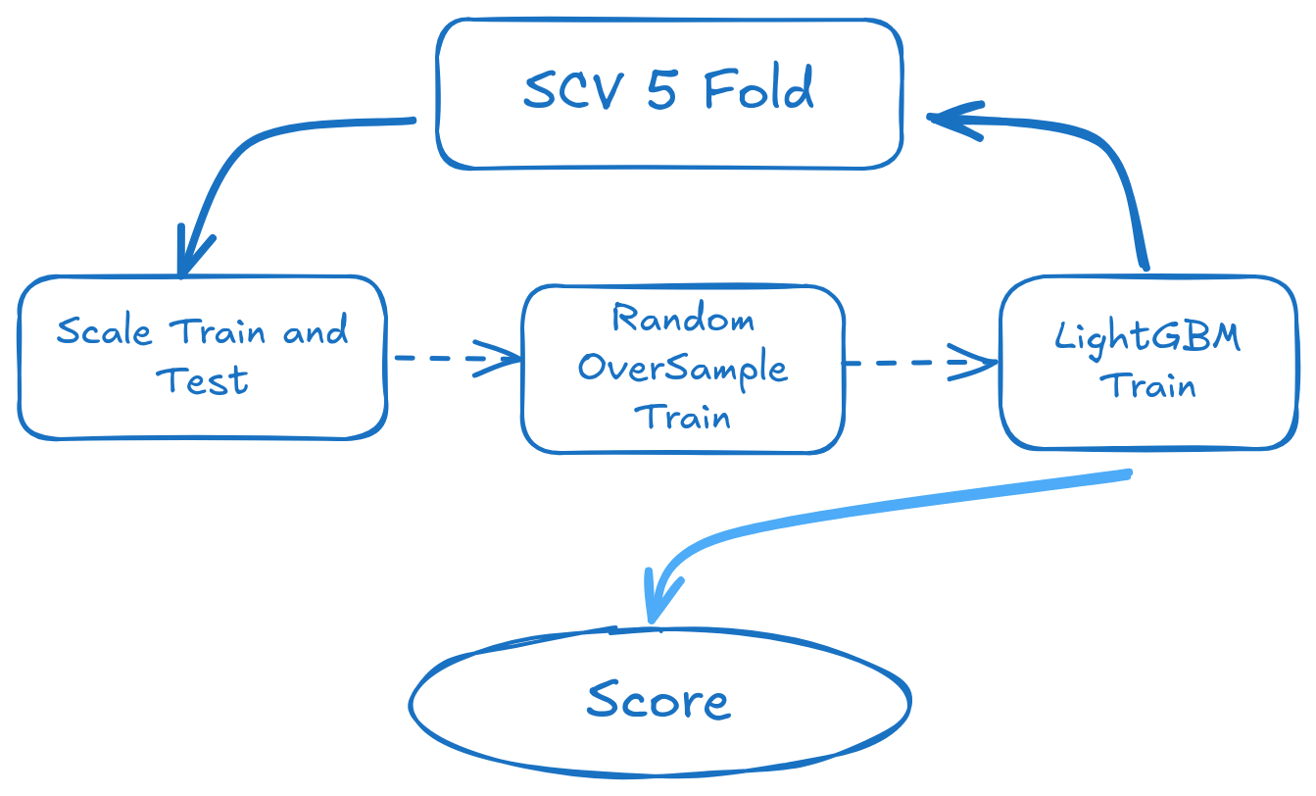
PREVIOUS WORK
Crystal Structure Classification in ABO3 Perovskites
Reference:
Behara, S., Poonawala, T., & Thomas, T. (2020). Crystal structure classification in ABO3 perovskites via machine learning. Computational Materials Science, 188, 110191. https://doi.org/10.1016/j.commatsci.2020.110191, Accepted 16 November 2020

Slide 12
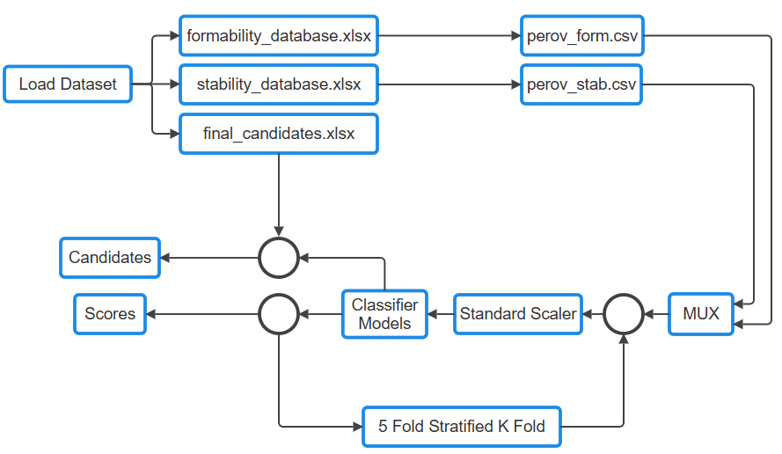
ONGOING WORK
Prediction of Formability and Thermodynamic Stability of Single and Double Perovskite Oxides

Slide 13
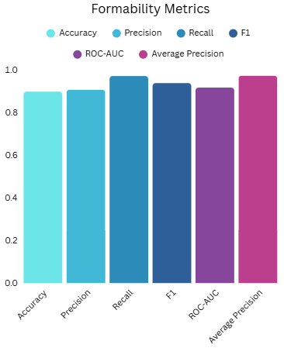
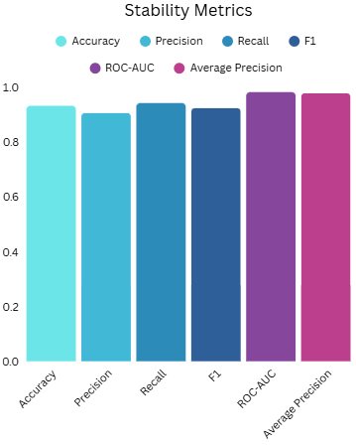
ONGOING WORK
Prediction of Formability and Thermodynamic Stability of Single and Double Perovskite Oxides

Slide 14
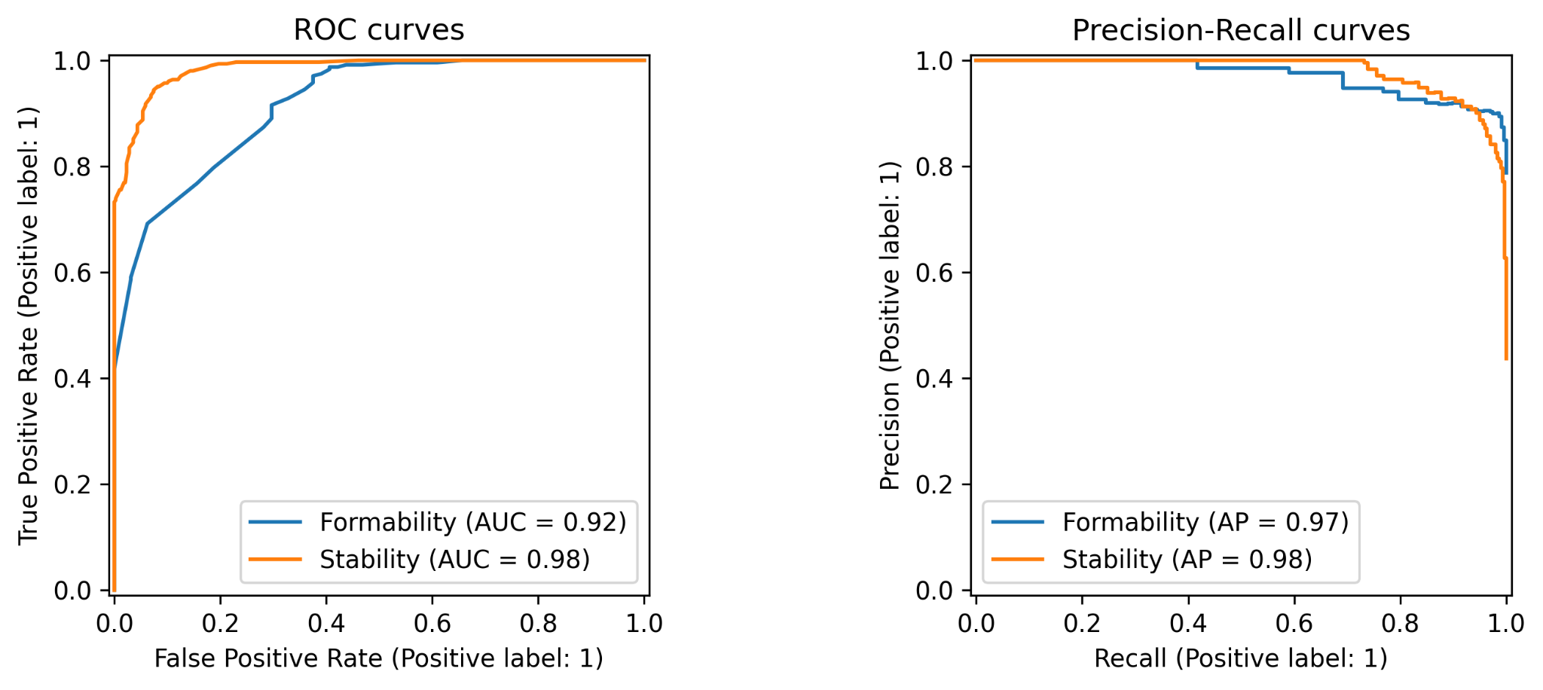
ONGOING WORK
Prediction of Formability and Thermodynamic Stability of Single and Double Perovskite Oxides

Slide 15
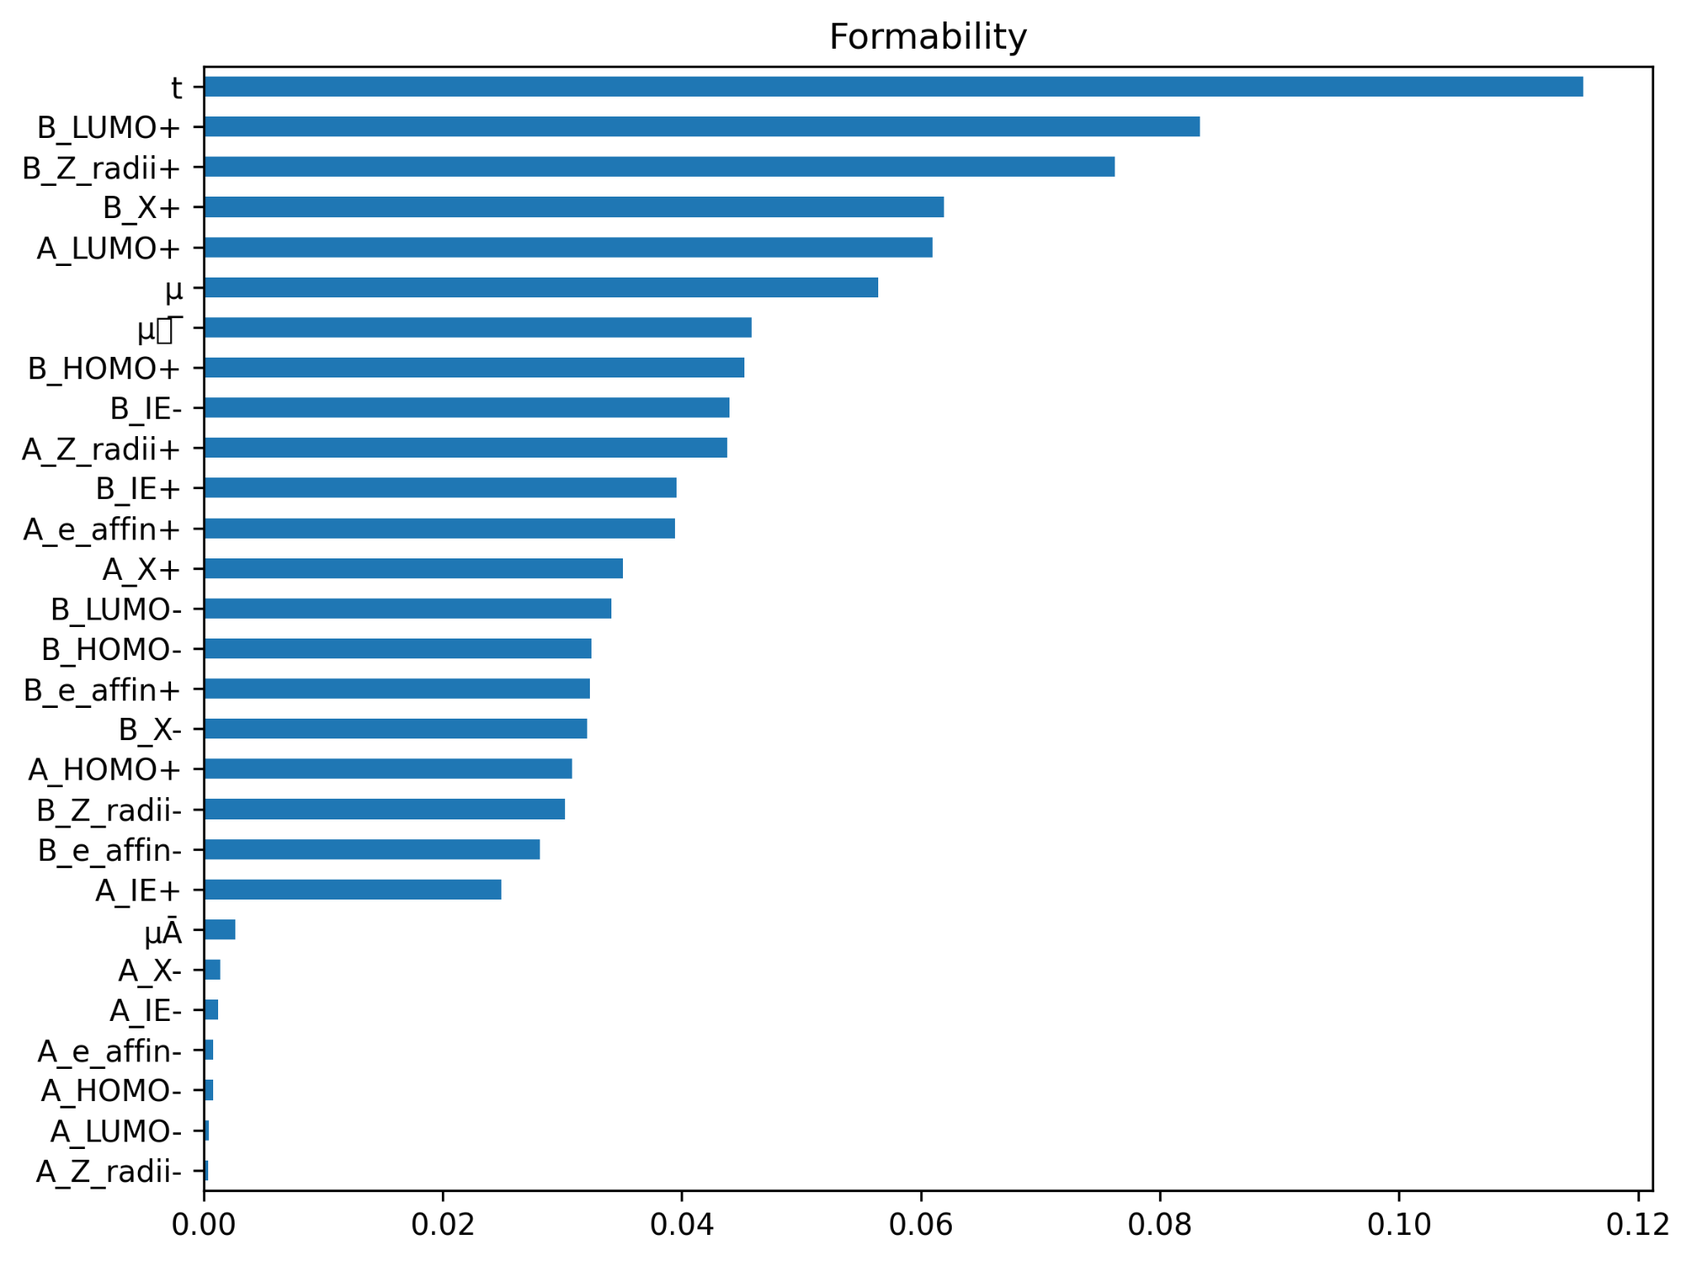
ONGOING WORK
Feature Importance

Slide 16
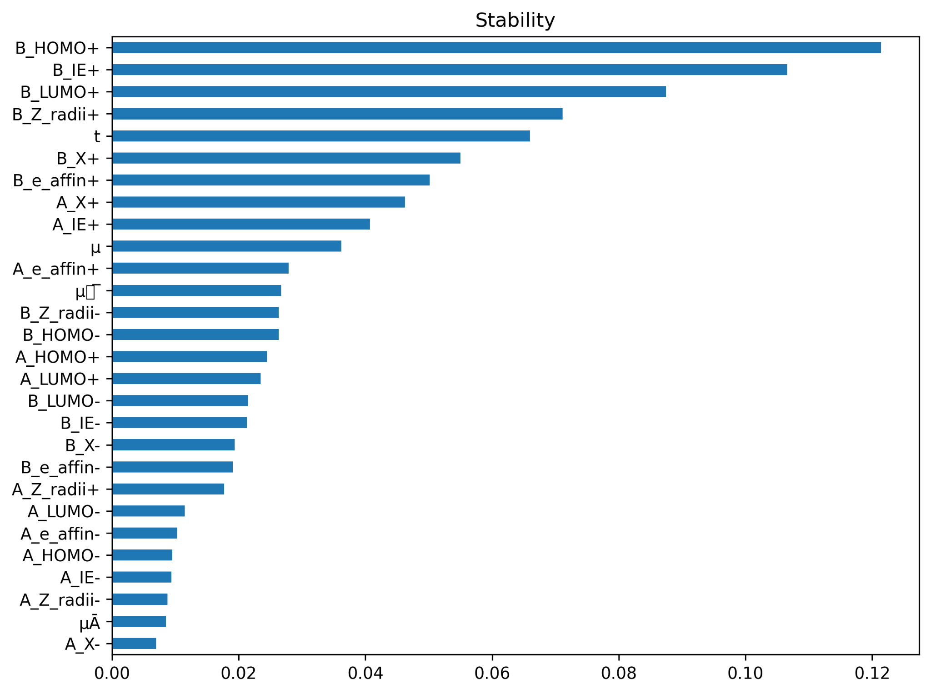
ONGOING WORK
Feature Importance

Slide 17



ONGOING WORK
OQMD
MULTI-CLASS
Crystal-system (7 classes → 4 after cleaning)
Worked on a dataset with 29K+ samples and 68 features
REGRESSION
REGRESSION
Band-gap (eV)
Formation Energy (eV/atom)

Slide 18
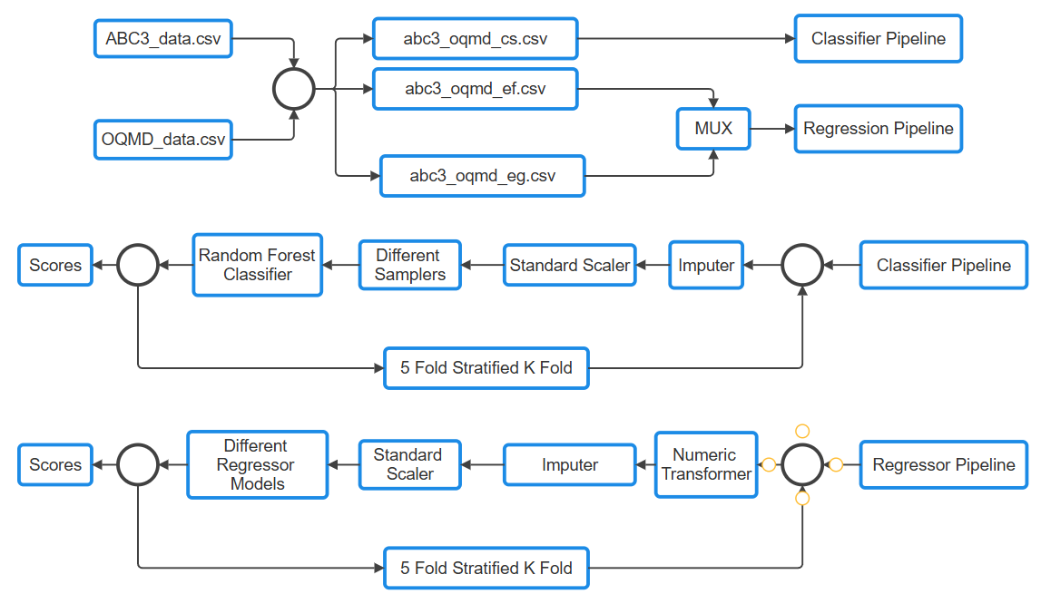
ONGOING WORK
OQMD

Slide 19
ONGOING WORK
OQMD
SVM – Support Vector Machine
01
02
RFR – Random-Forest Regressor
RFC – Random-Forest Classifier
03
04
XGB – eXtreme Gradient Boosting
LGB – Light Gradient Boosting Machine
05
06
RidgeCV – Ridge Regression with built-in Cross-Validation
Used Models
ElasticNet – Elastic-Net Regression
07
08
LogRegCV – Logistic Regression with built-in Cross-Validation
KNN – k-Nearest Neighbours
09
10
CatBoost – Categorical Boosting

Slide 20
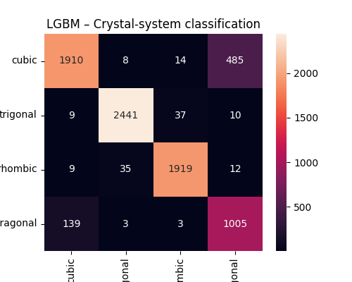
ONGOING WORK
OQMD

Slide 21
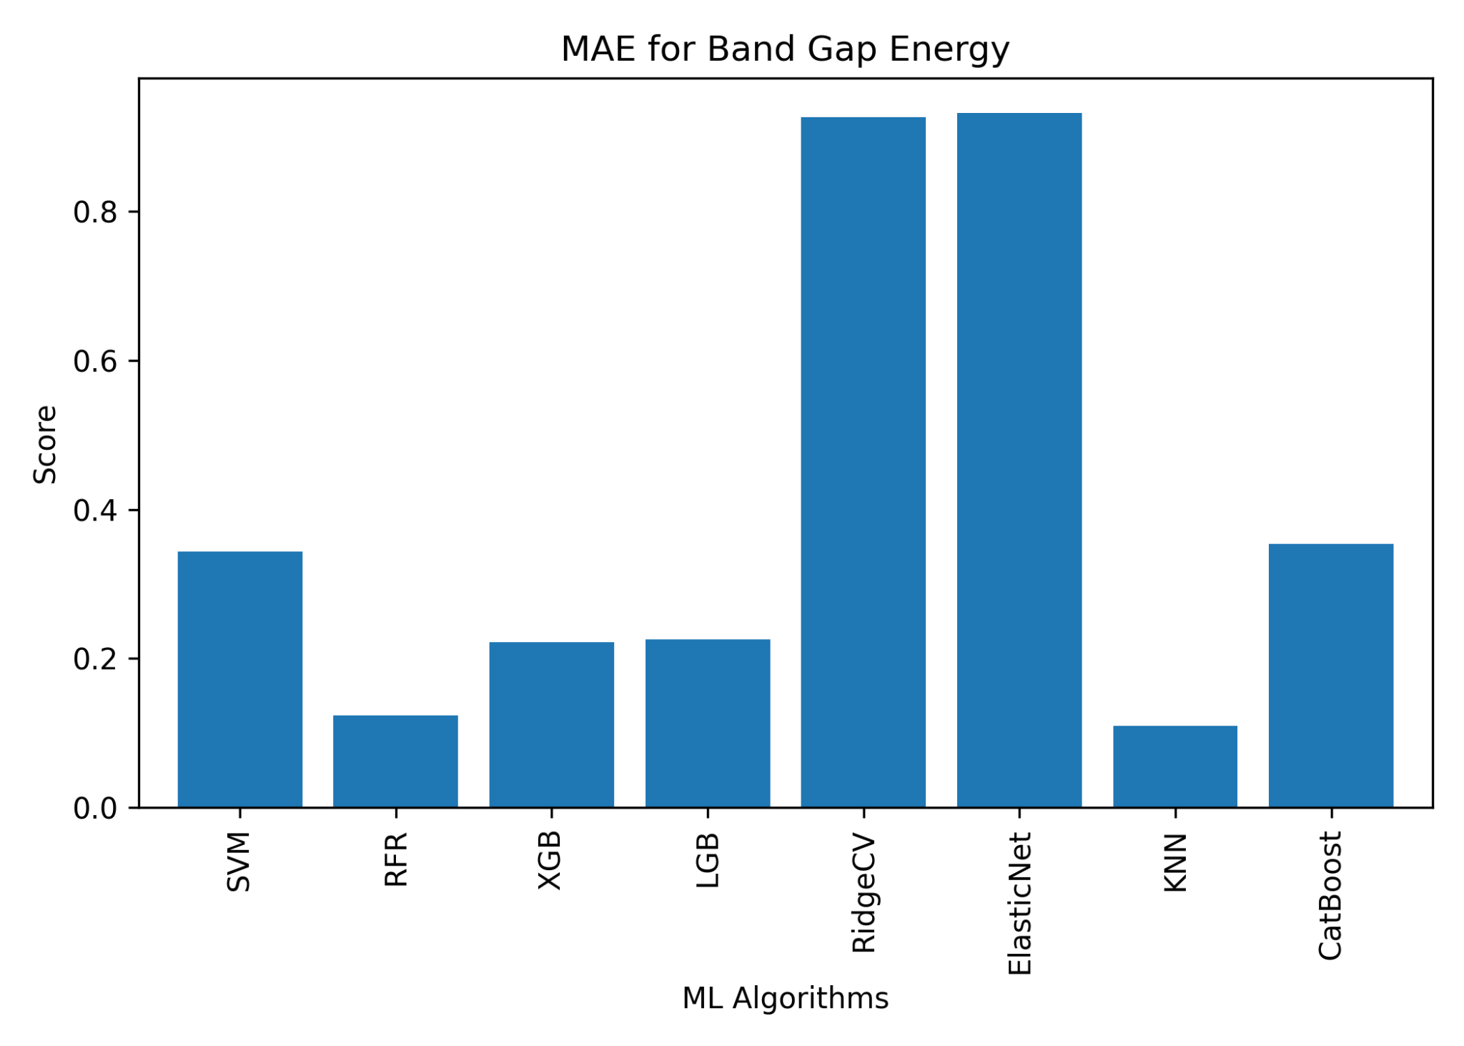
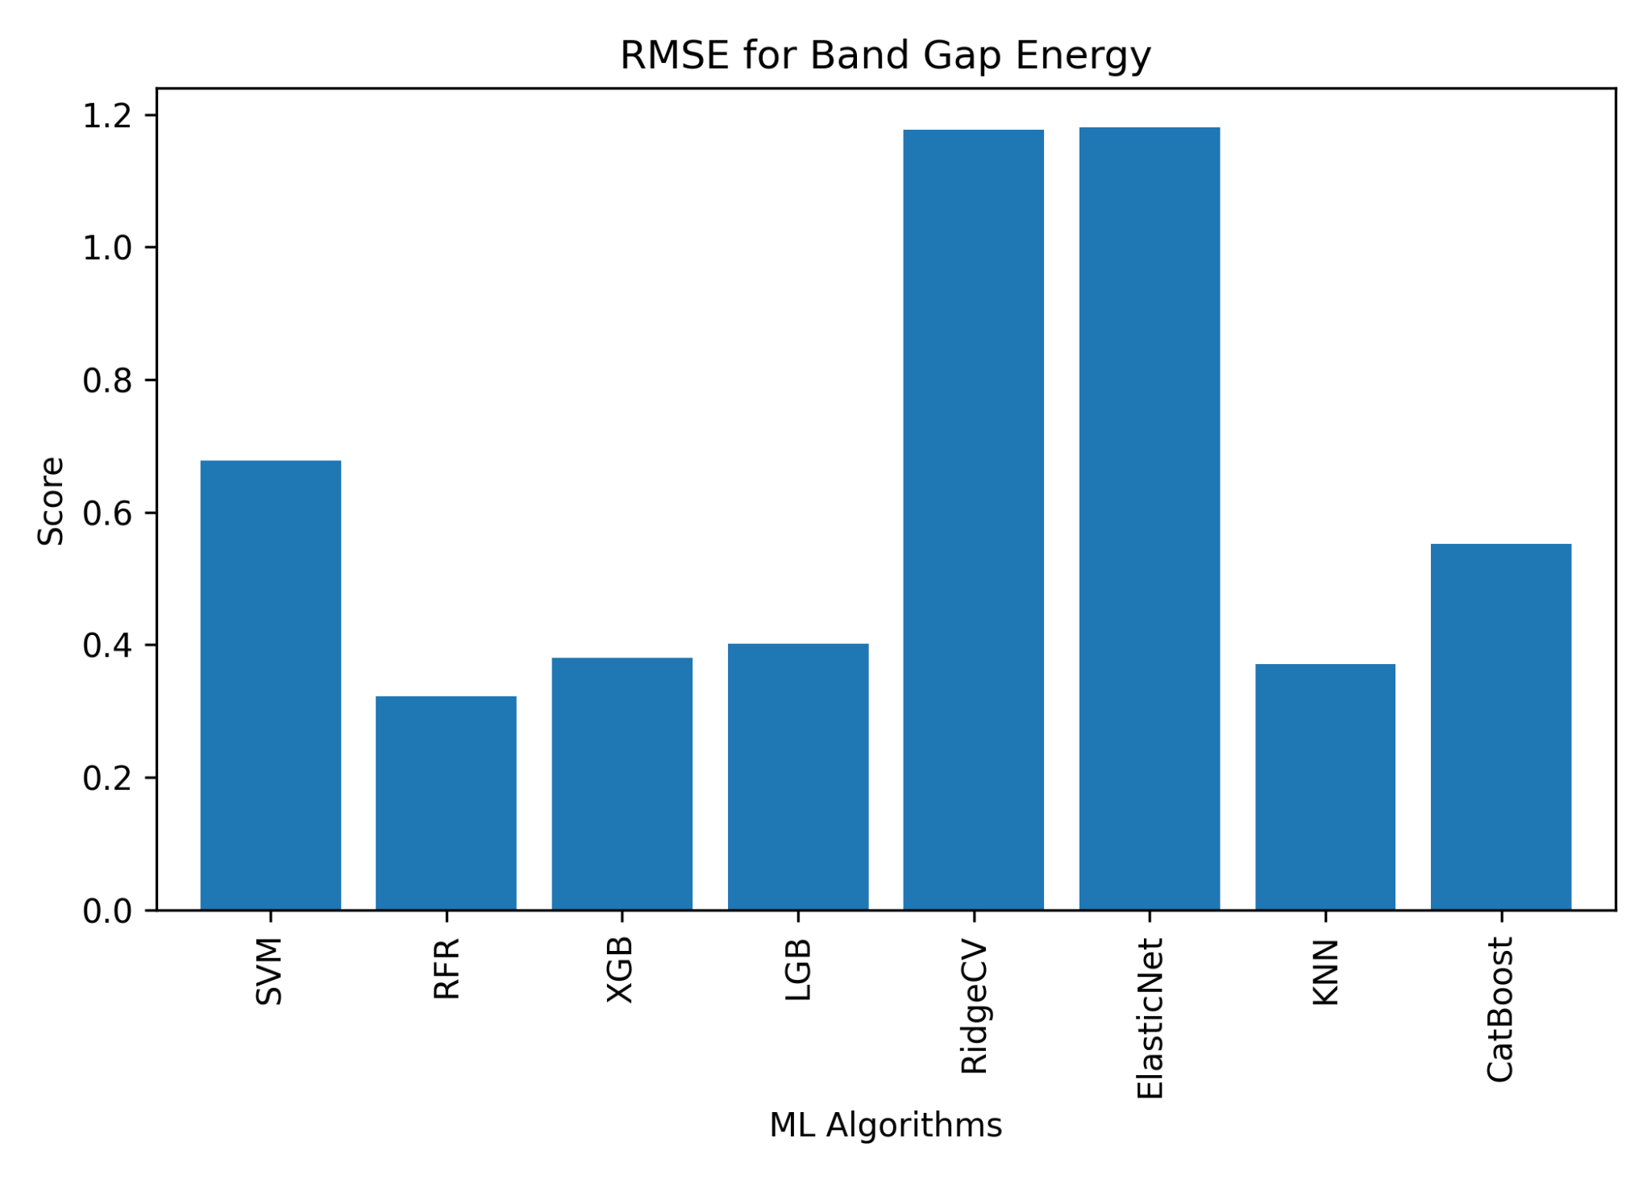
ONGOING WORK
For Bandgap Energy

Slide 22
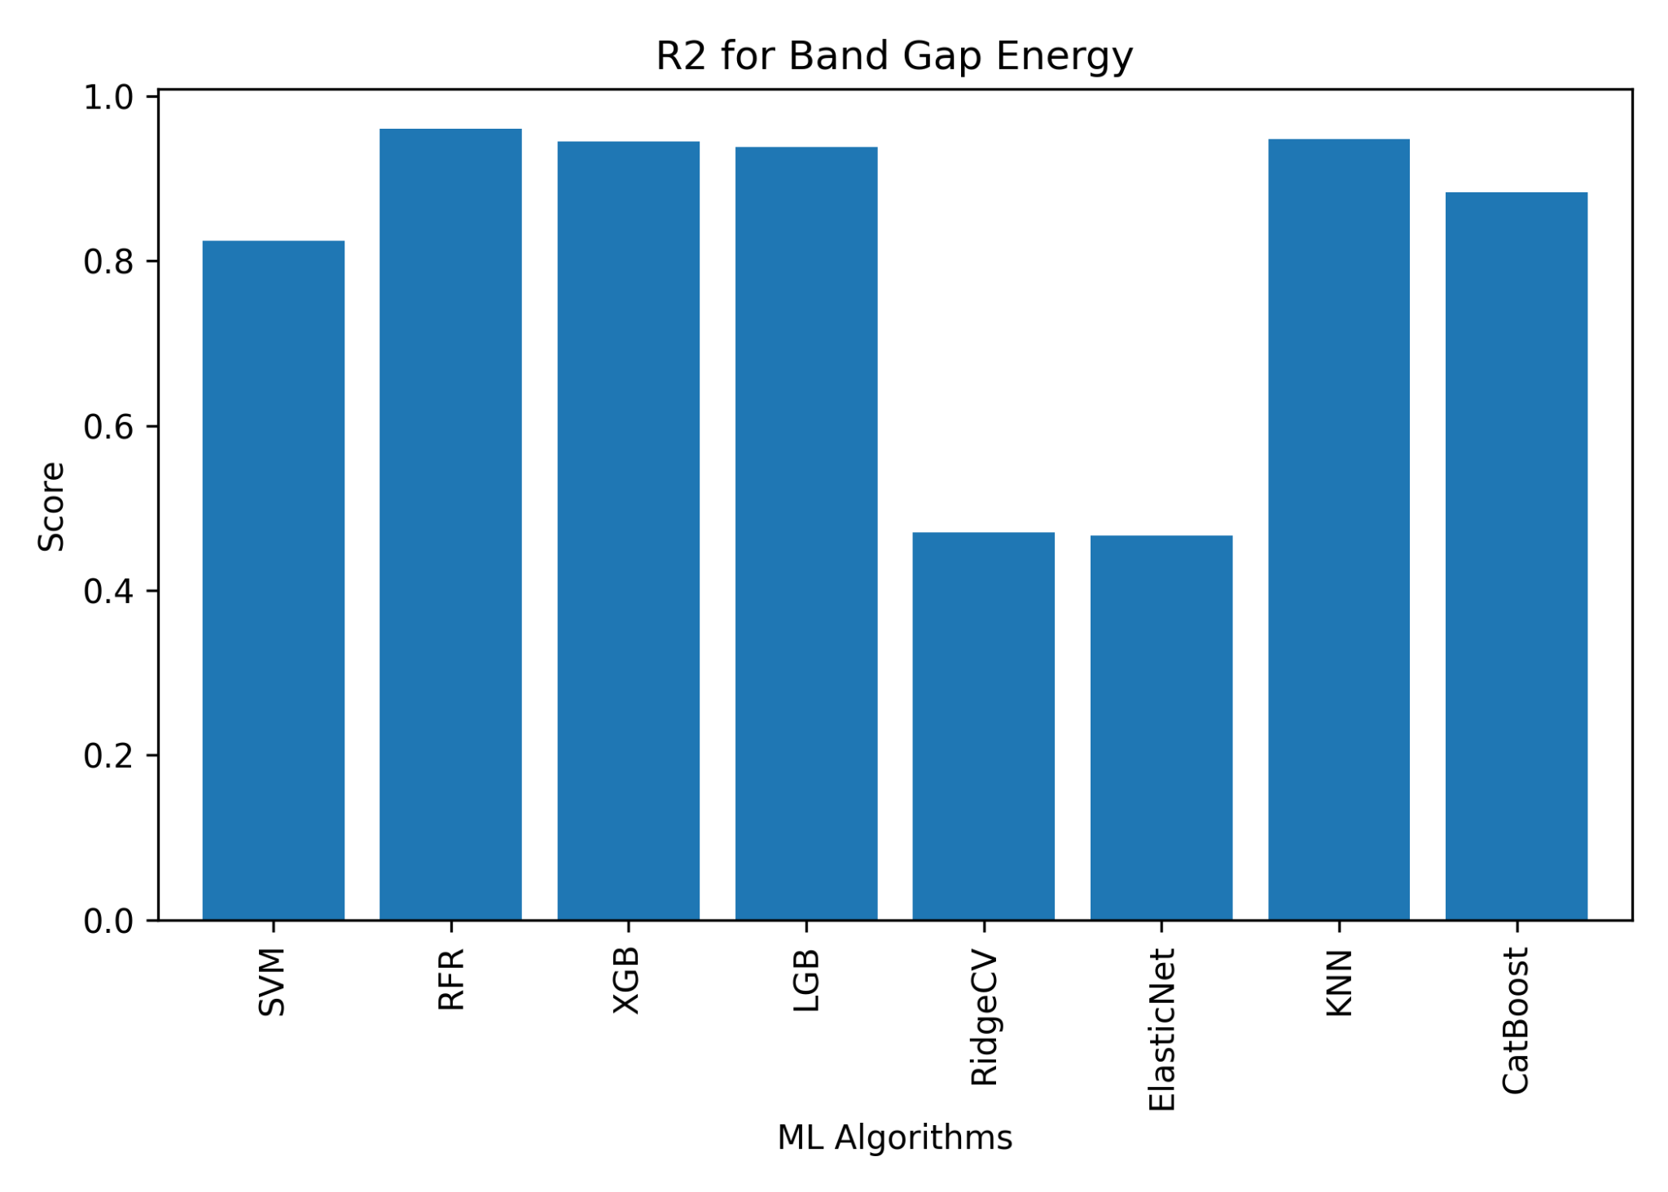
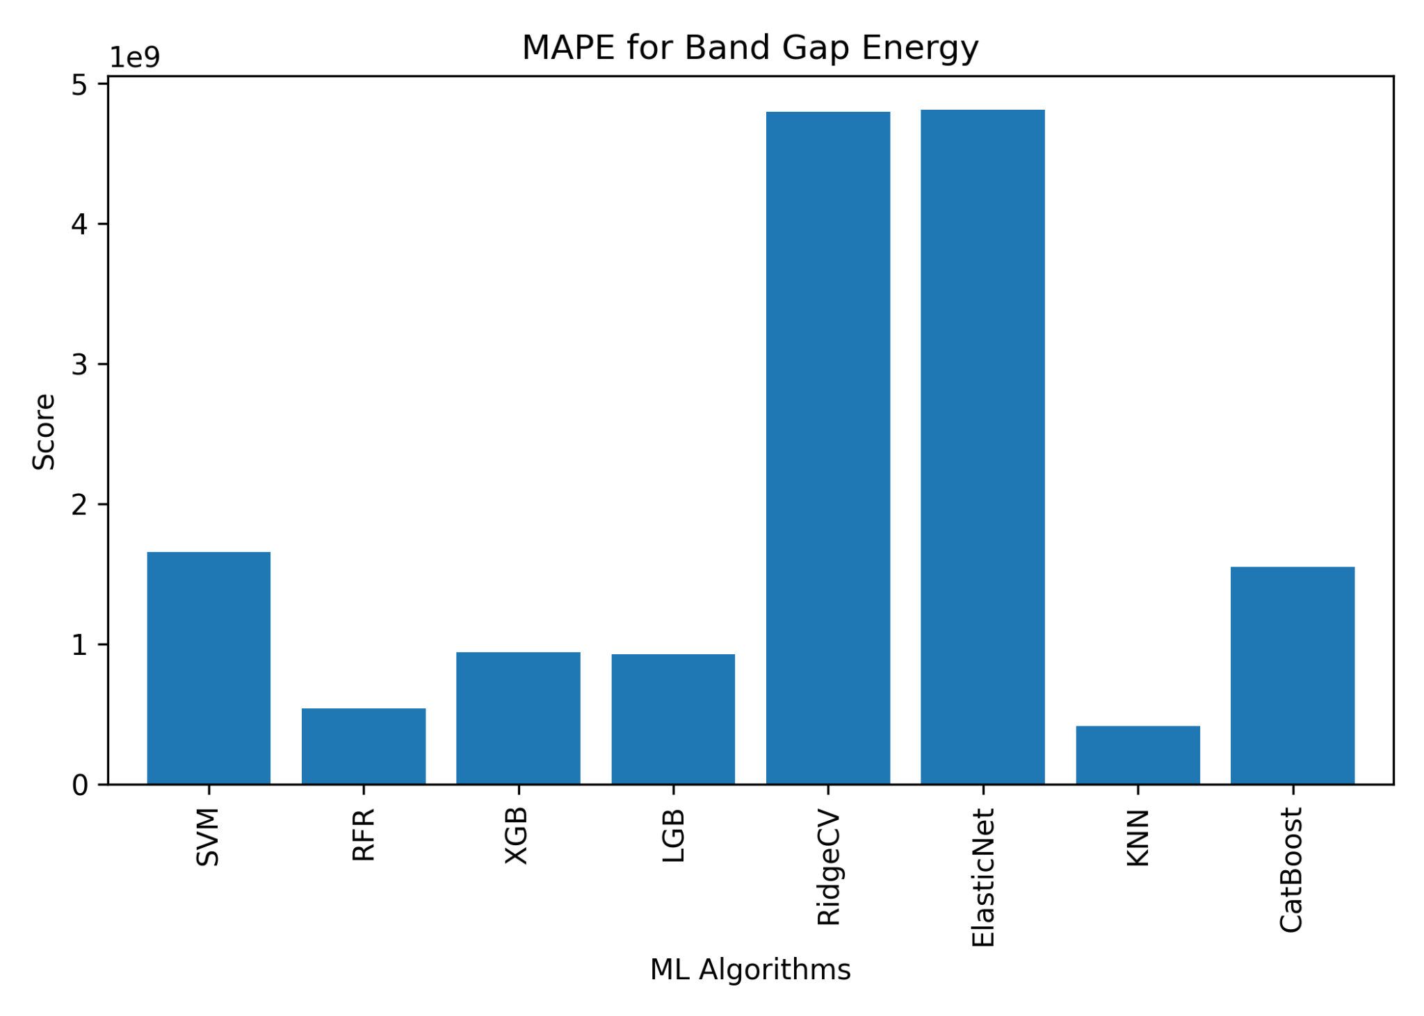
ONGOING WORK
For Bandgap Energy

Slide 23
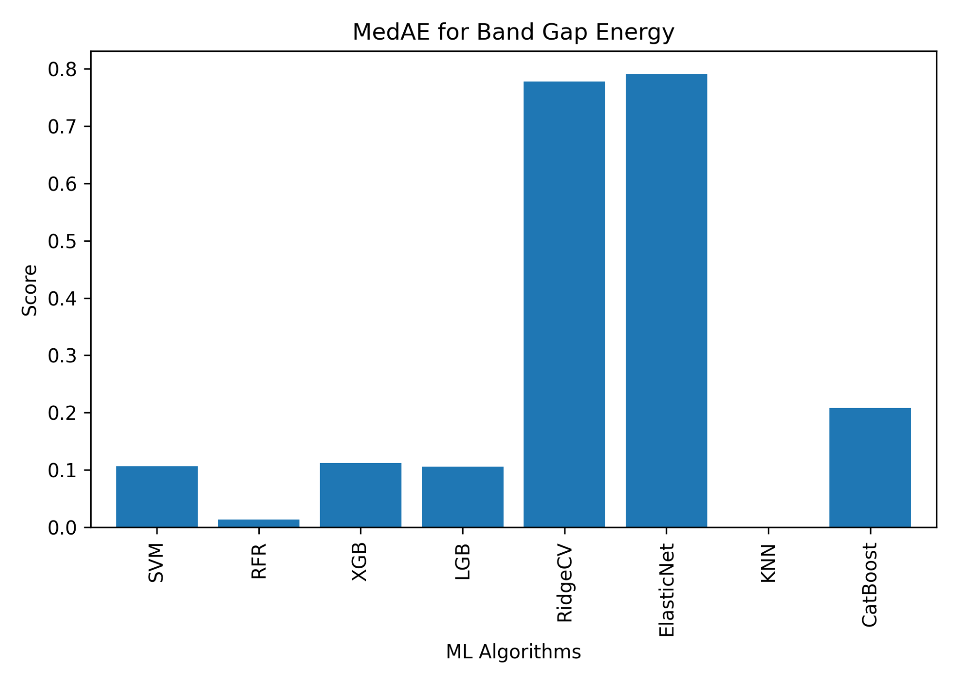
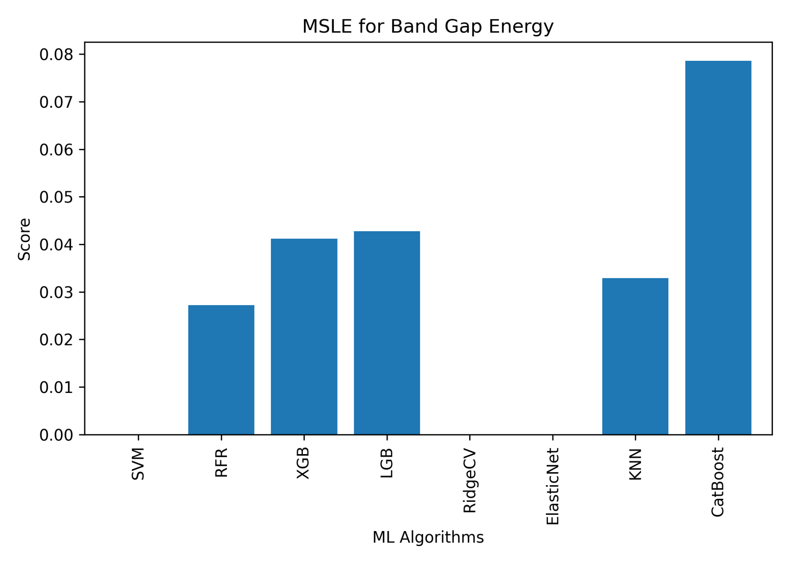
ONGOING WORK
For Bandgap Energy

Slide 24
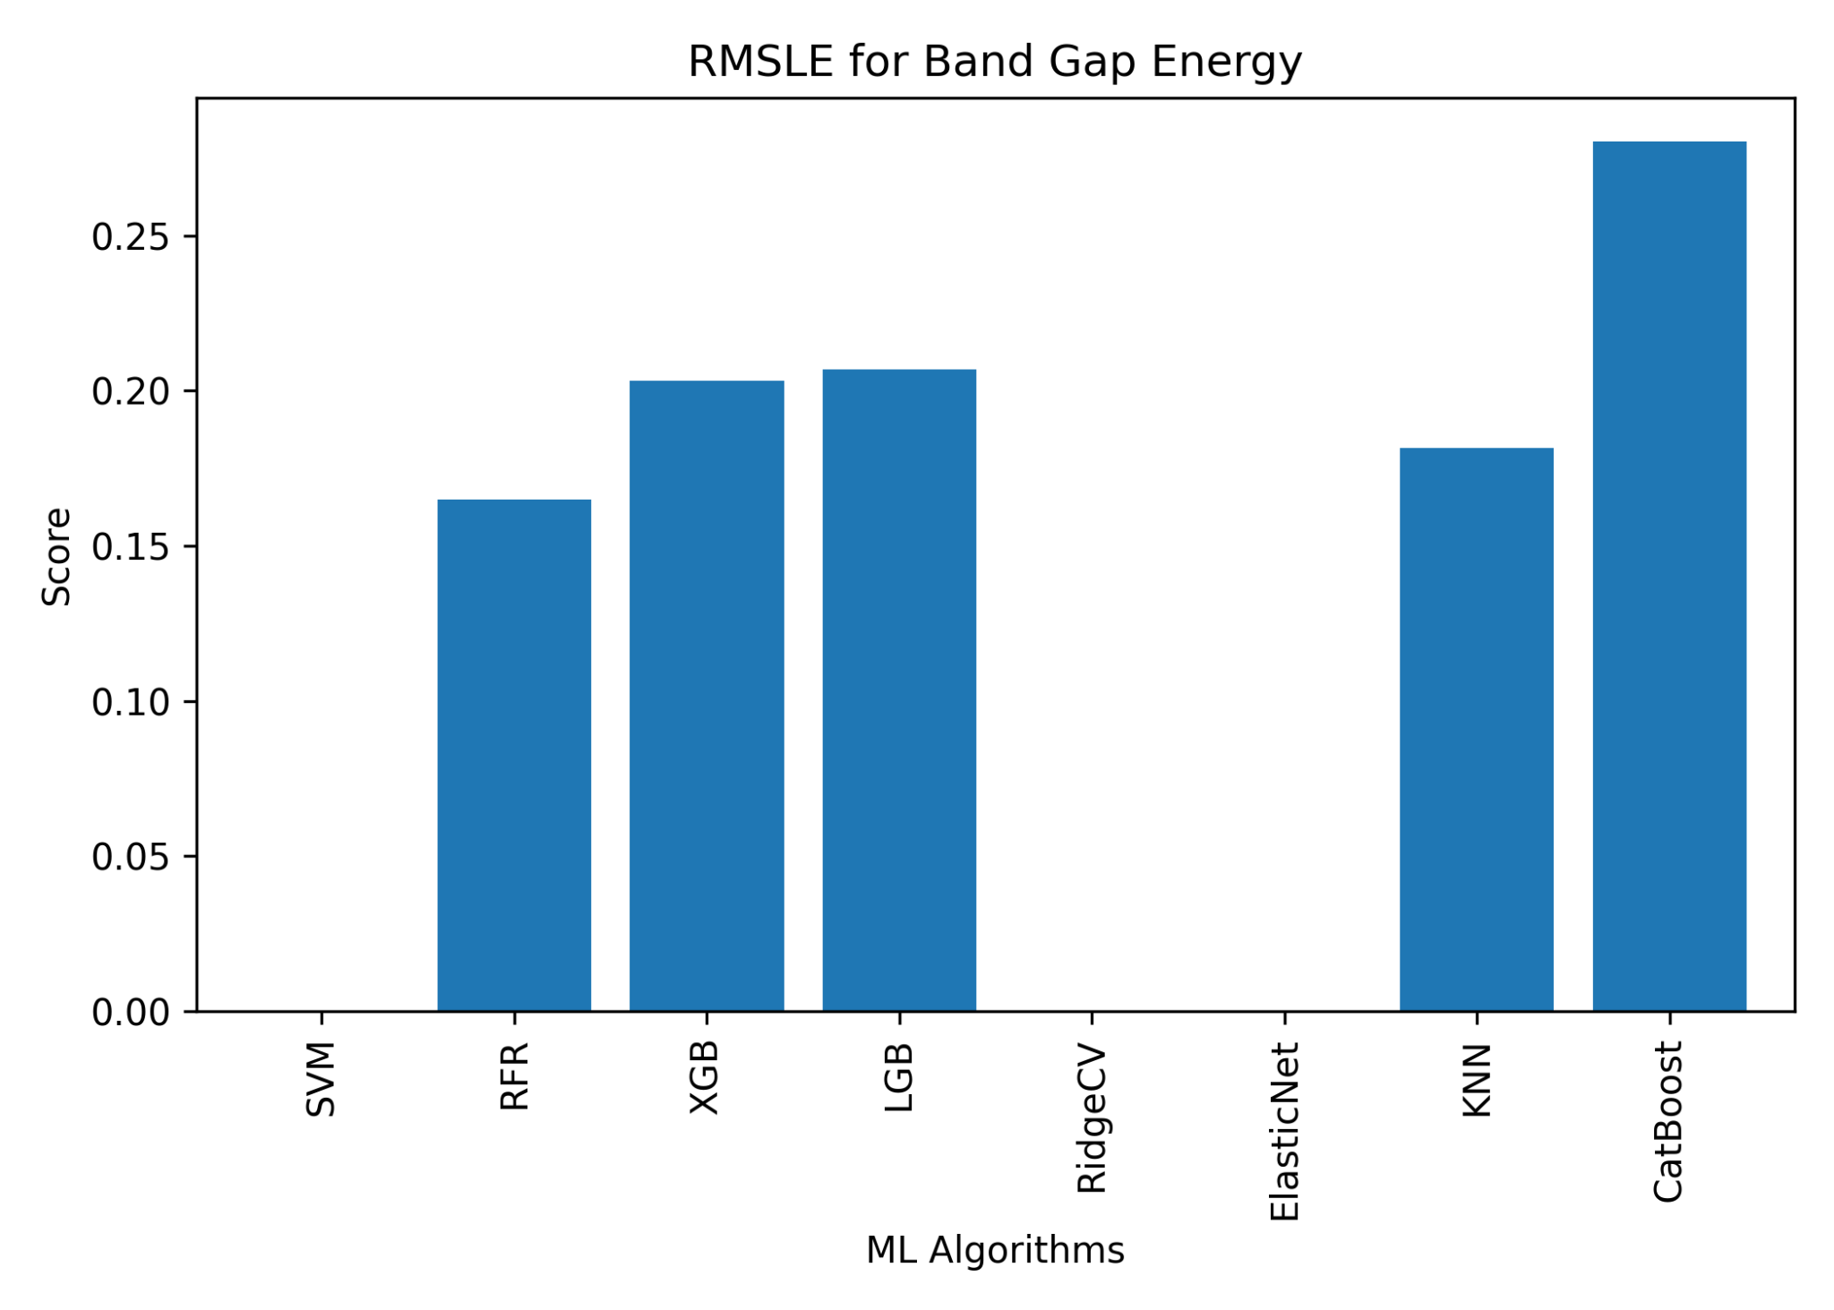
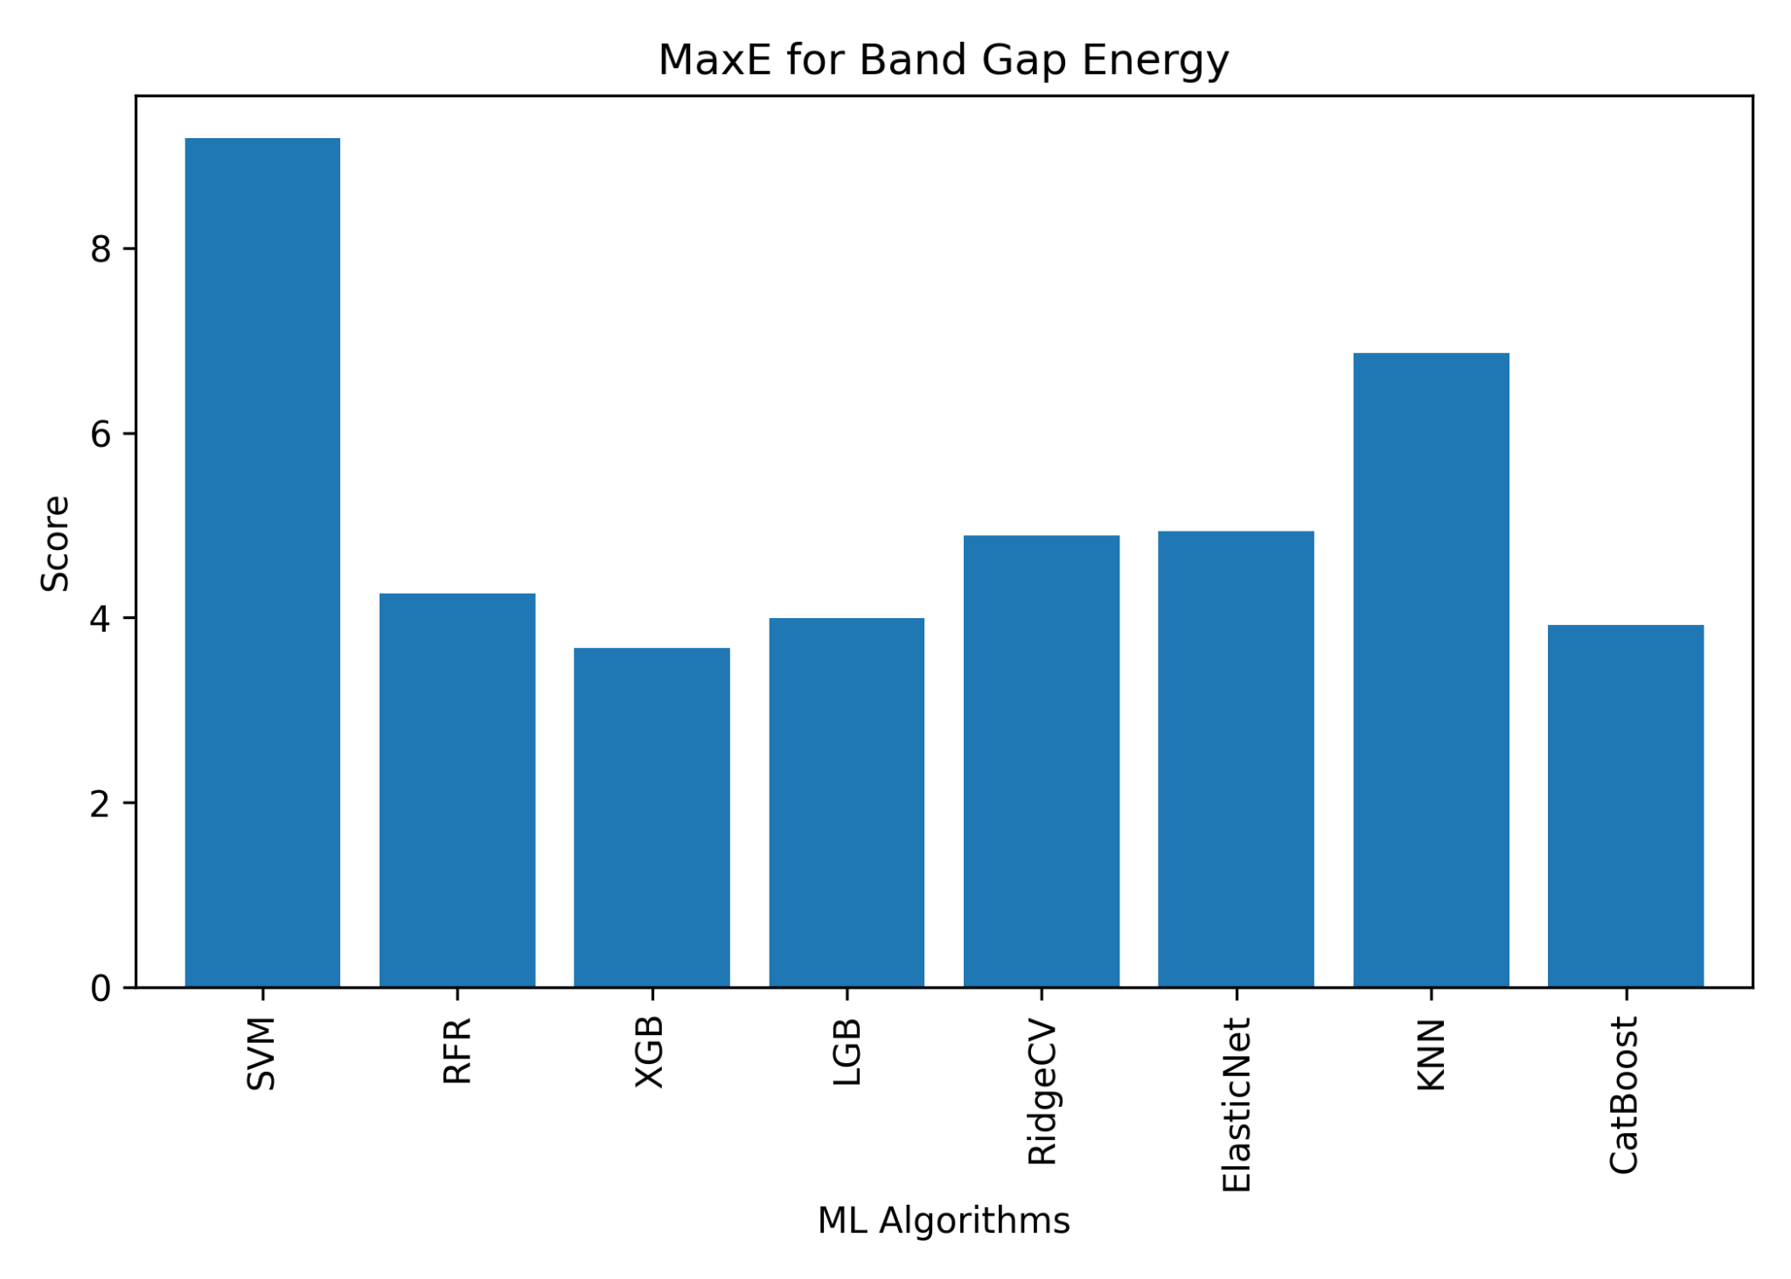
ONGOING WORK
For Bandgap Energy

Slide 25

ONGOING WORK
For Bandgap Energy

Slide 26
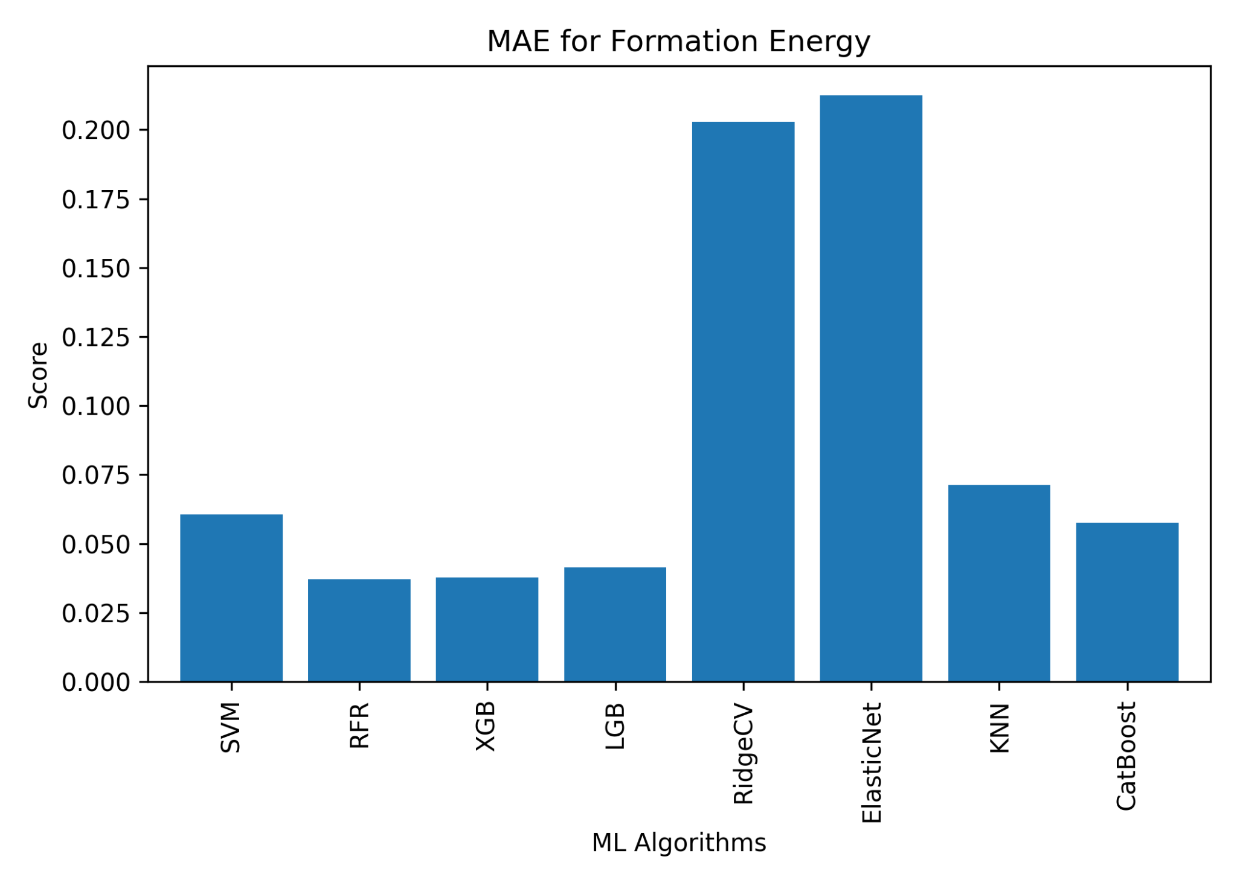
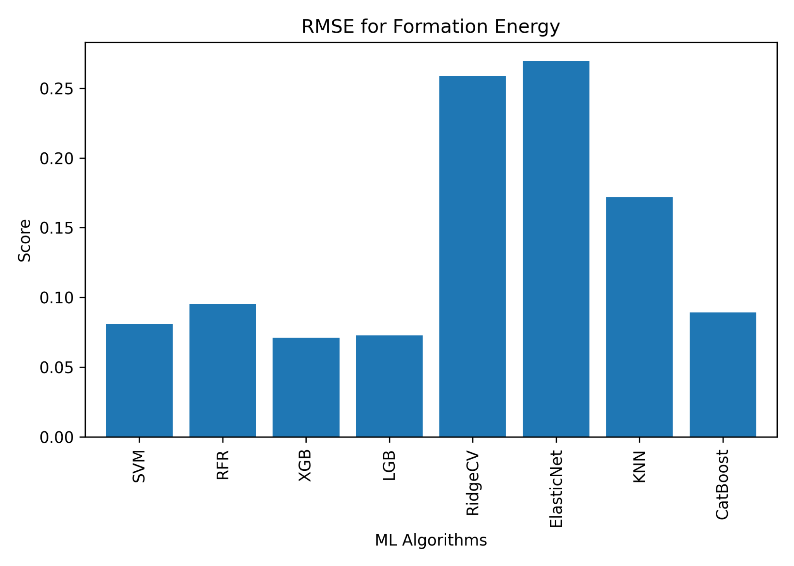
ONGOING WORK
For Formation Energy

Slide 27
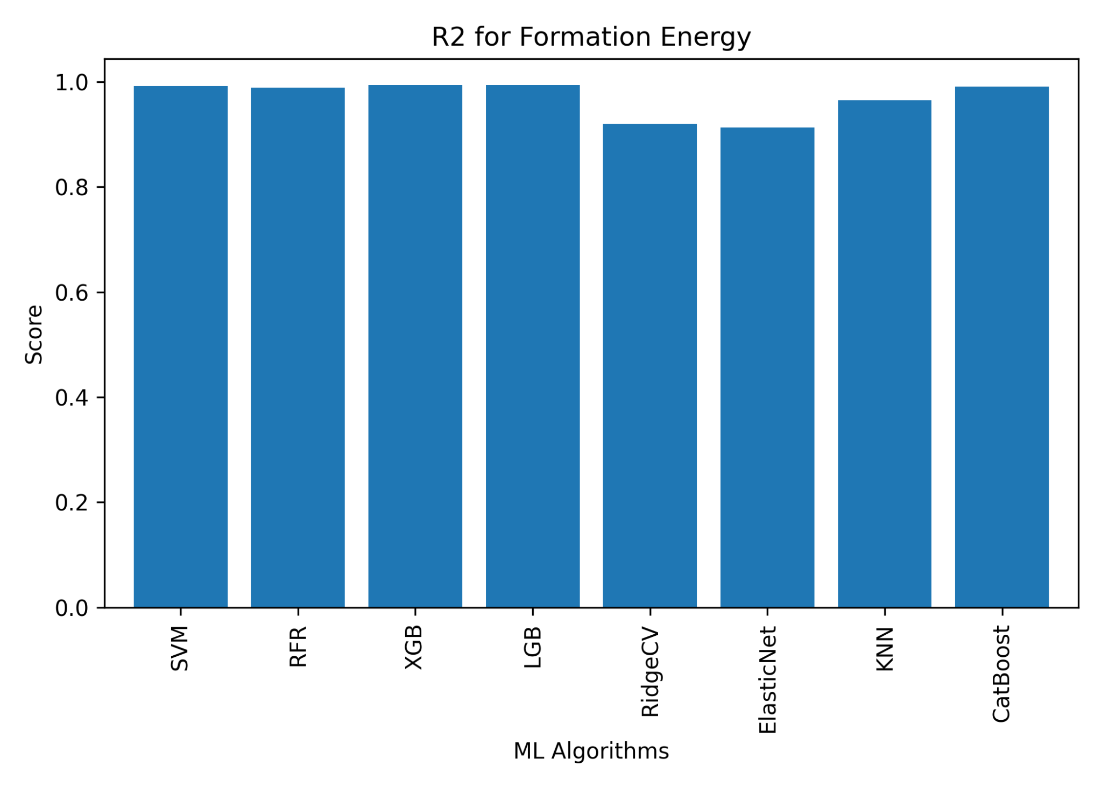
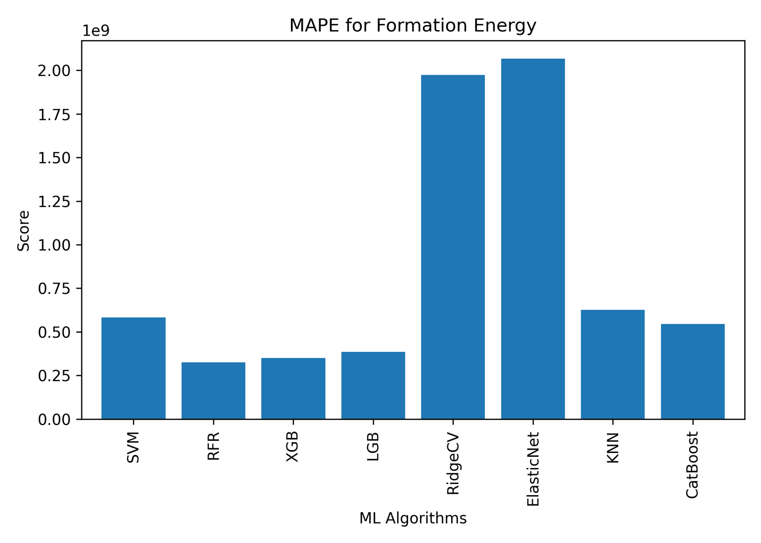
ONGOING WORK
For Formation Energy

Slide 28
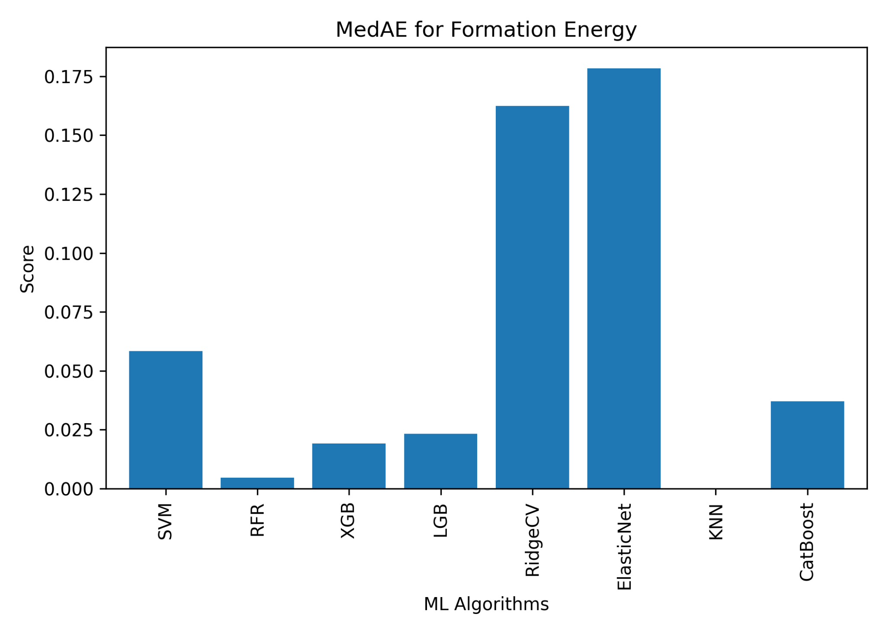
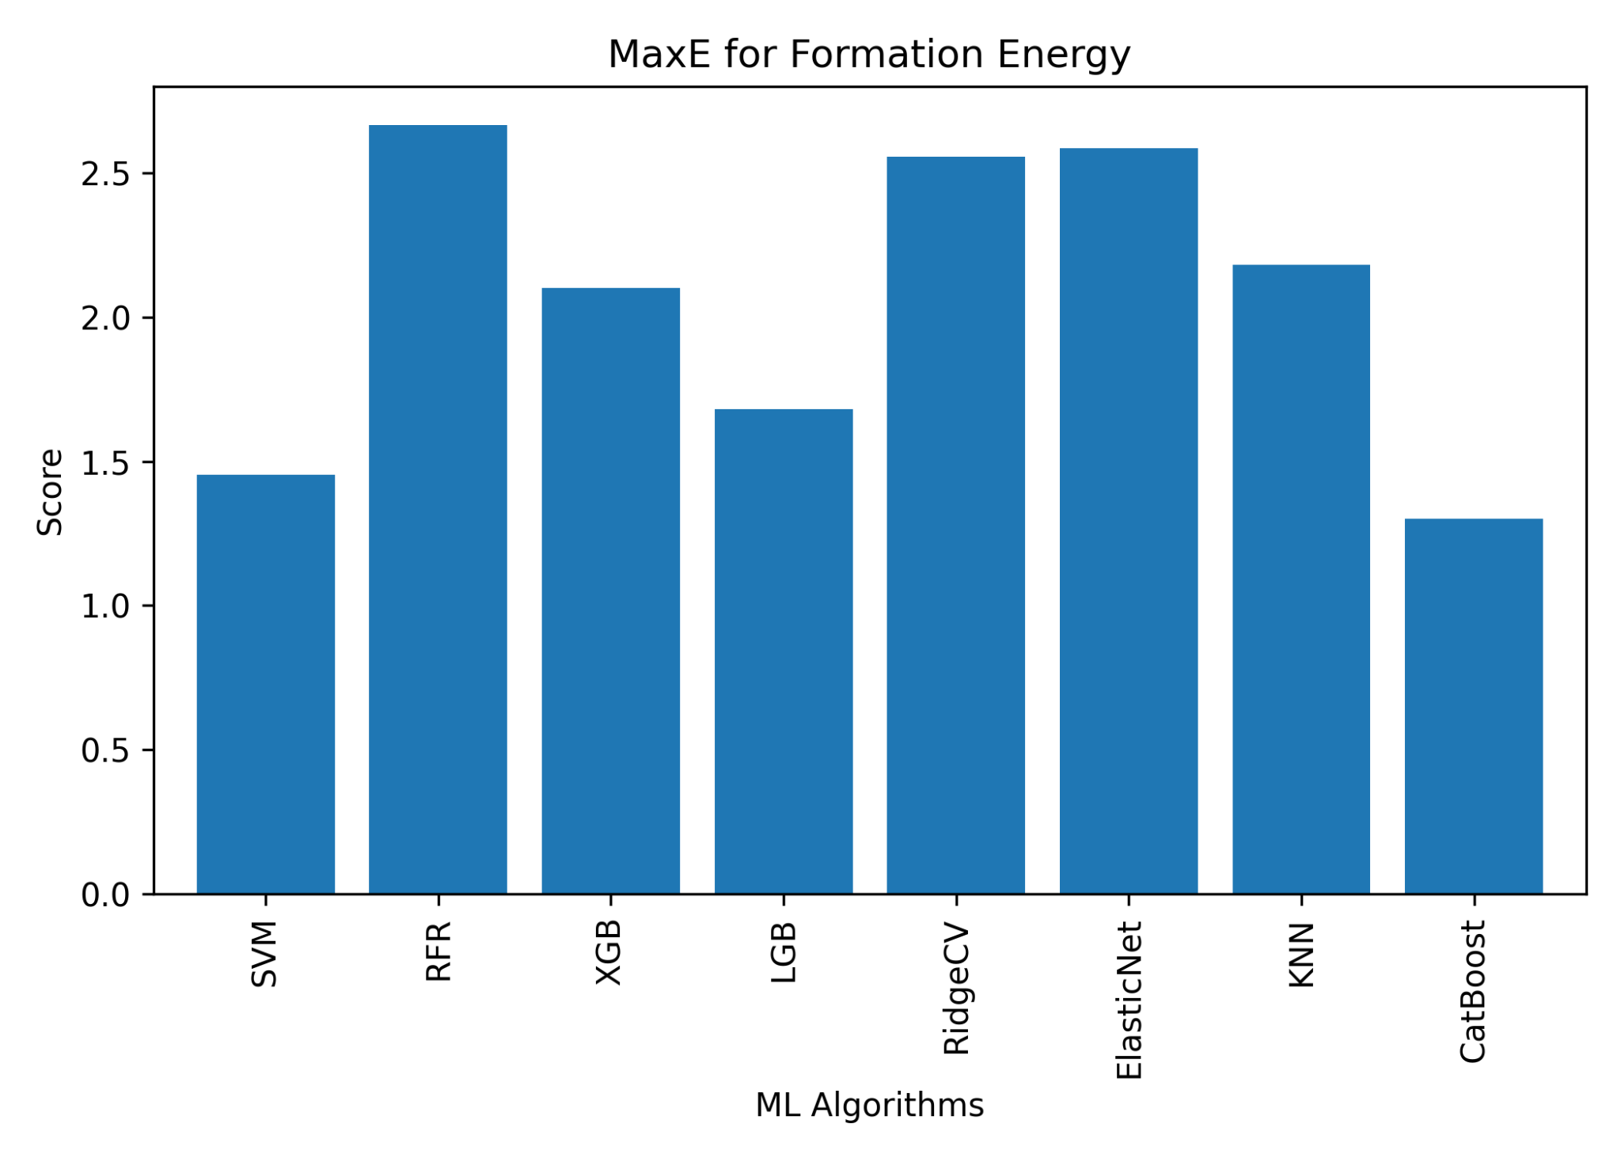
ONGOING WORK
For Formation Energy

Slide 29
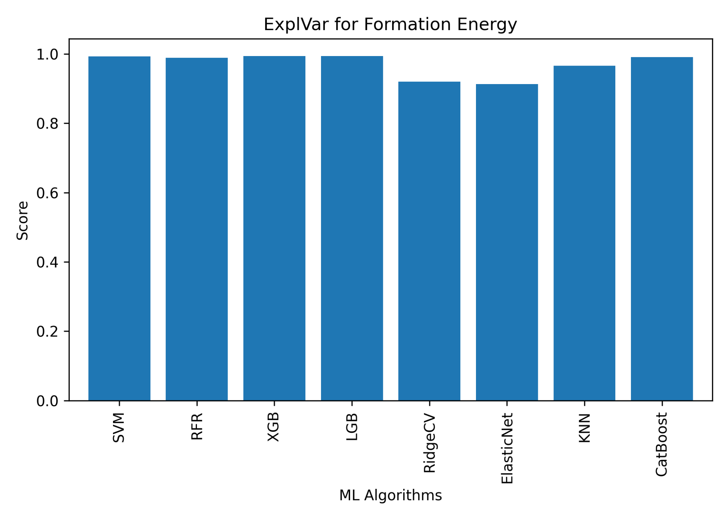
ONGOING WORK
For Formation Energy

Slide 30
ONGOING WORK
Sampling Comparison
01
SMOTE
02
OVERSAMPLE
Datasets
03
DOWNSAMPLE
abc3_oqmd_cs.csv
perov_form.csv
perov_stab.csv
04
CNN
05
NC
06
ICOST
07
HYBRID DD

Slide 31
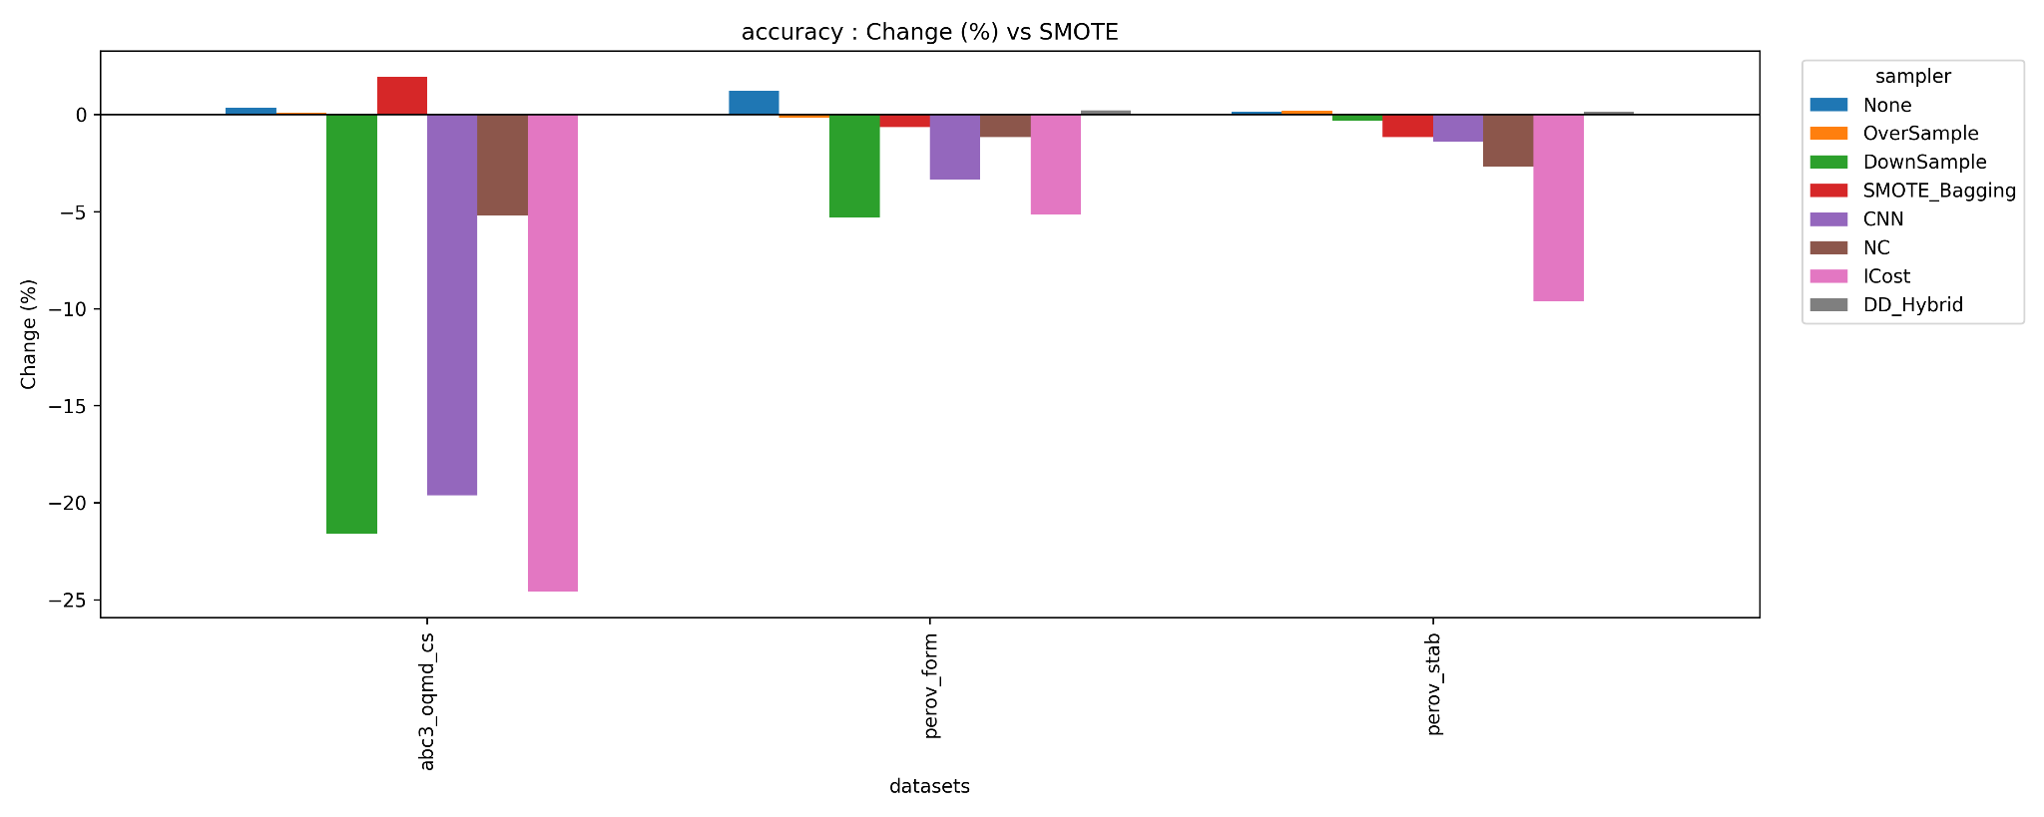
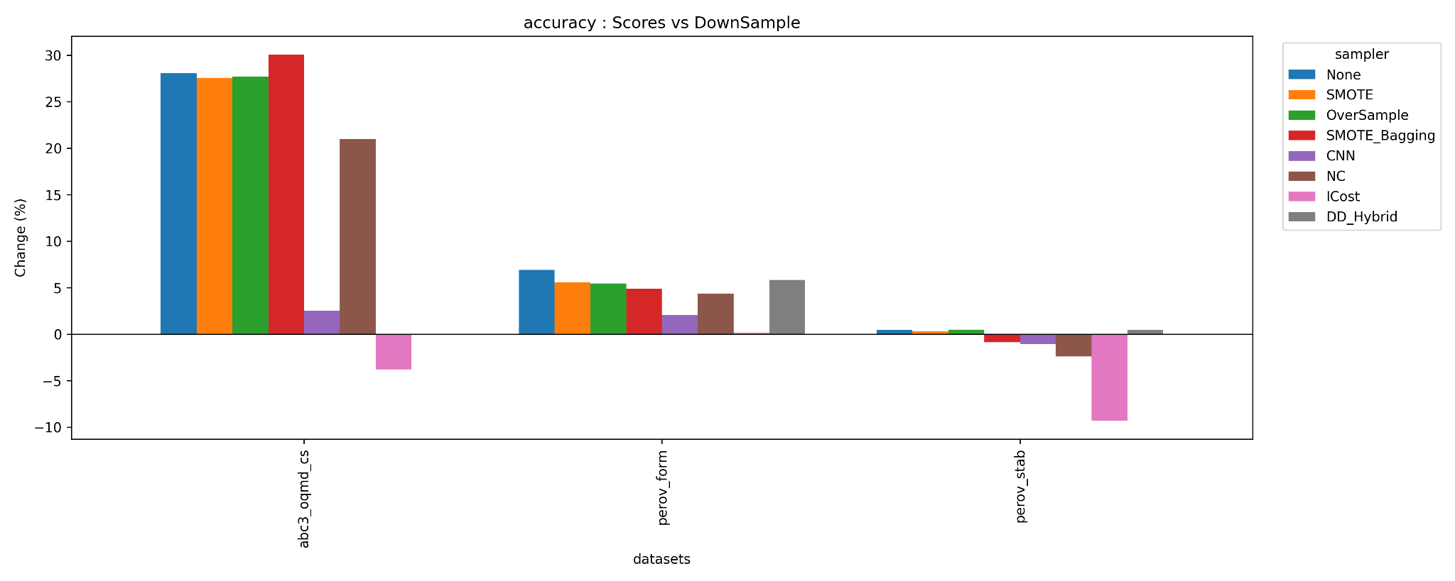
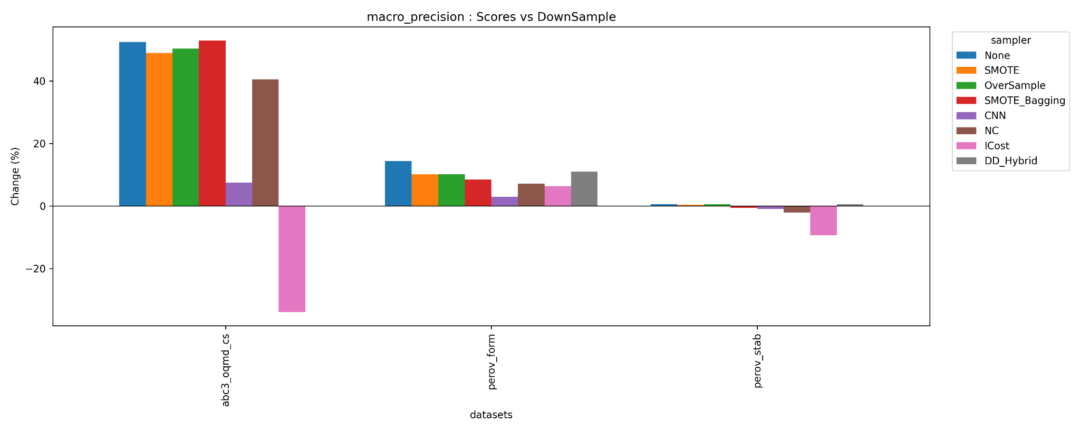
ONGOING WORK
Sampling comparison

Slide 32
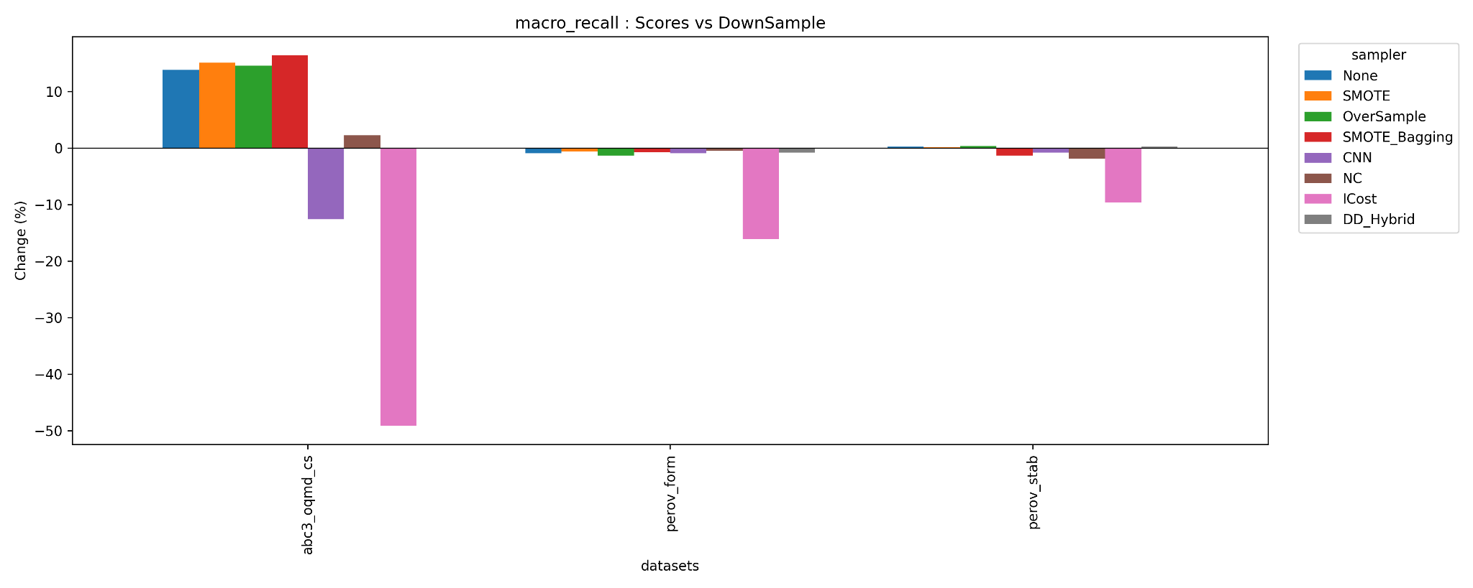
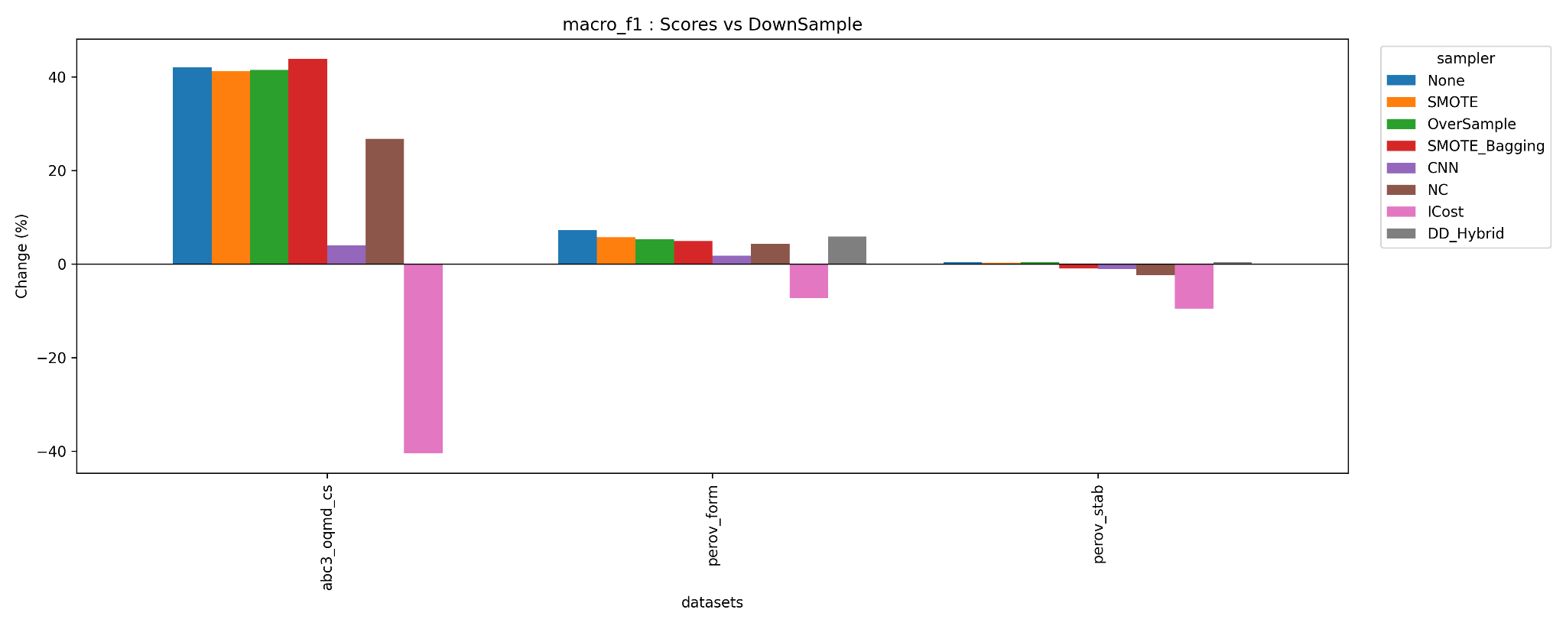
ONGOING WORK
Sampling comparison

Slide 33
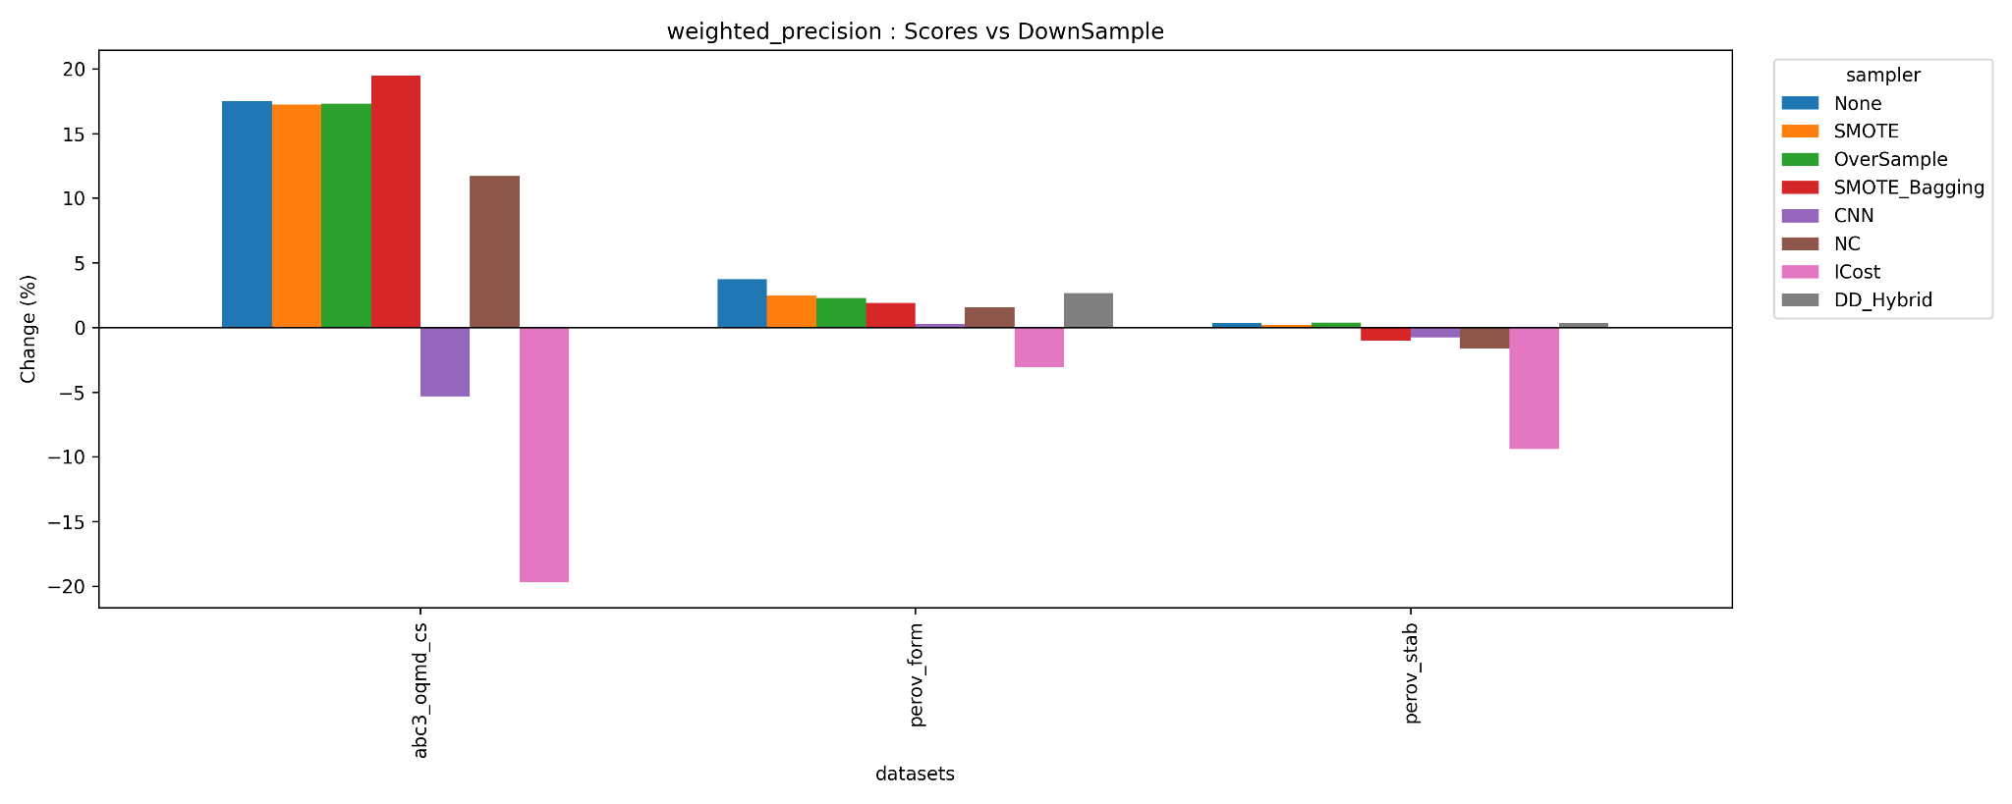

ONGOING WORK
Sampling comparison

Slide 34
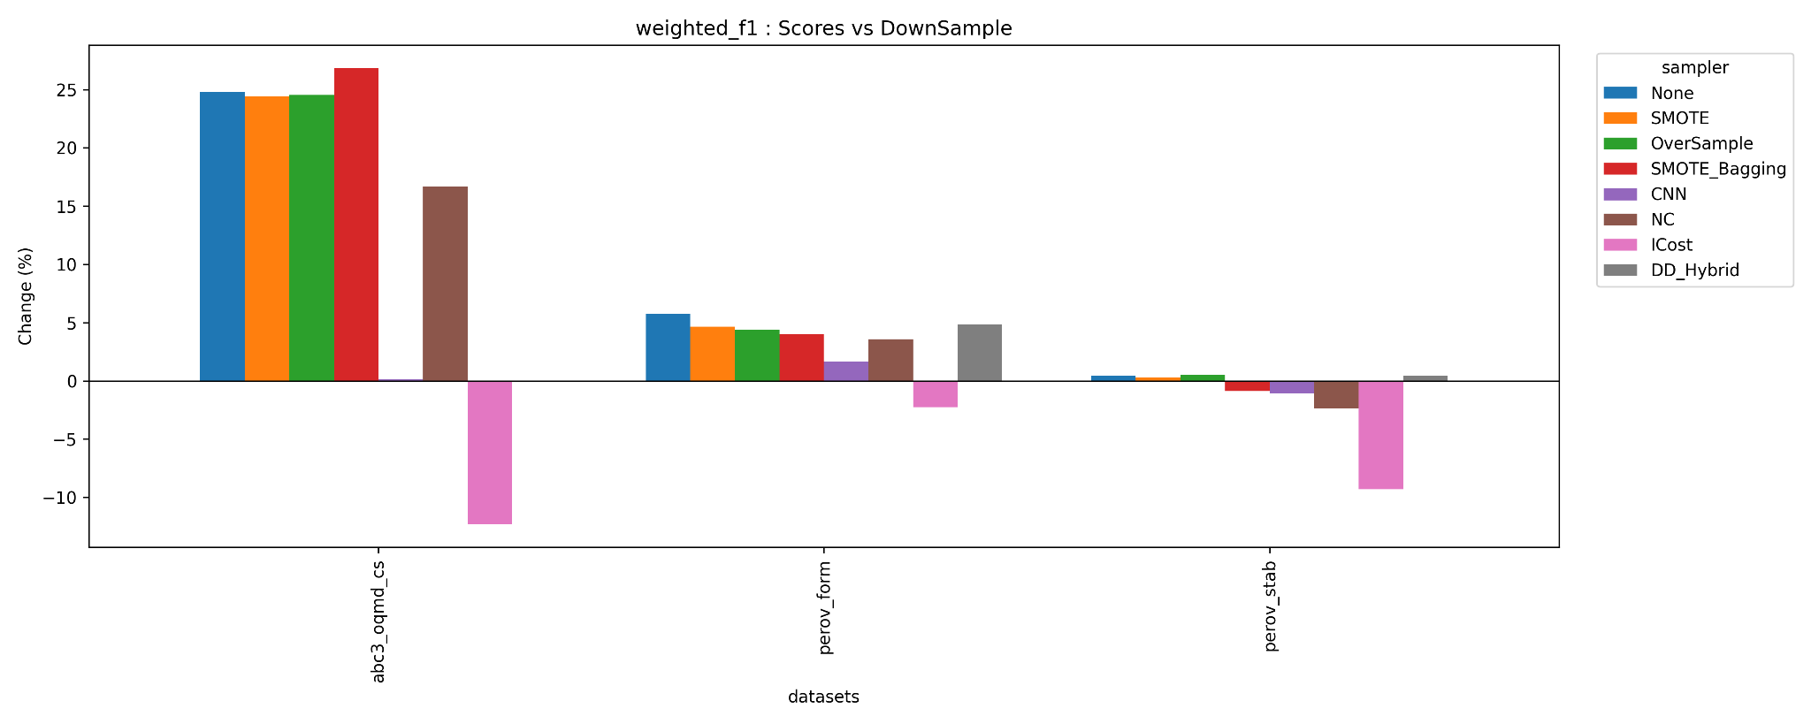
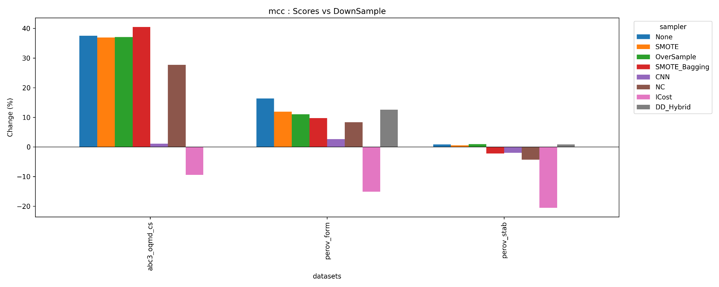
ONGOING WORK
Sampling comparison

Slide 35
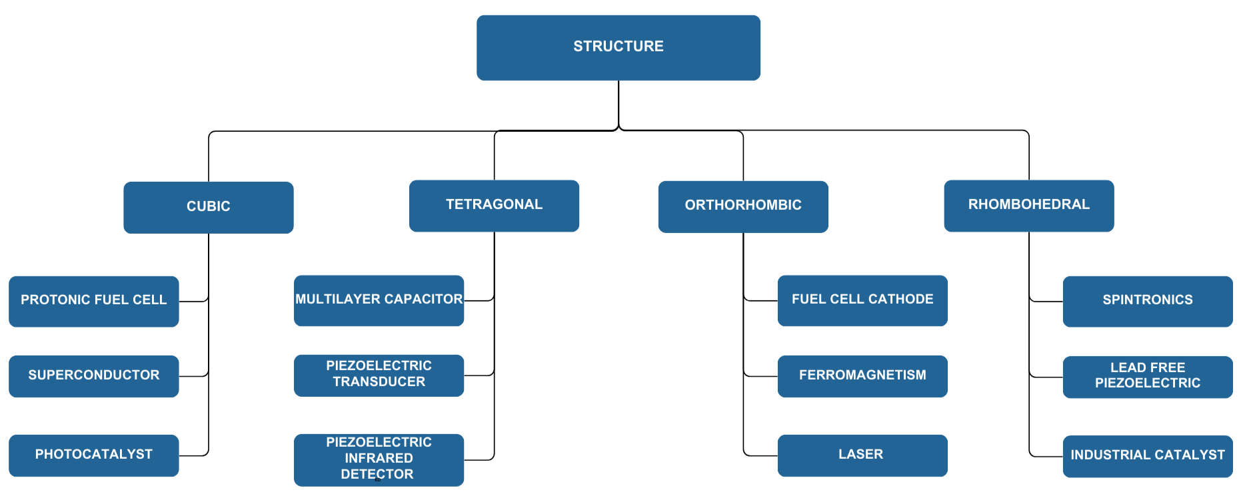
APPLICATION
Reference:
Behara, S., Poonawala, T., & Thomas, T. (2020). Crystal structure classification in ABO3 perovskites via machine learning. Computational Materials Science, 188, 110191. https://doi.org/10.1016/j.commatsci.2020.110191, Accepted 16 November 2020

Slide 36
LIMITATIONS
Oversampling
Overfitting Risk, Class Boundary Distortion and Minority Class Noise
01
RUS
(Random Undersampling)
Data Loss, Loss of Important Information and Bias towards Minority class
02
Limitations
Neighbourhood Cleaning (NC) Challenges
03
Noisy KNN Stats in High Dimensions
04
Fragile Minority Sets (<20)
05

Slide 37
FUTURE SCOPES
Efficacy Analysis of Sampling Methods on Multi Class Dataset
07
Use Stronger Guards or Cost Sensitive Learning
06
Multiple Majority Class Issue
05
Solving Class Overlap Issue
04
Hybrid Sampling Methods
03
Difference in Class Size
02
Scaling/PCA
01

Slide 38
The following table explains or justifies how the COs and corresponding POs have been addressed in EEE 4700/4800 (Project and Thesis).
COs | POs | Explanation/Justification
CO1 | PO2 | Our project addresses the slow and costly nature of traditional materials discovery methods, which is a significant challenge in material science and engineering.
CO2 | PO4 | This project synthesizes data from materials databases and applies ML models based on those needs.
CO3 | PO8 | Ethical consideration were taken into account when designing the experiments. None of the methods used in this project has conflict with professional norms.
CO4 | PO5 | We used a combination of cutting-edge software libraries and programming languages designed for data analysis and machine learning in order to adopt contemporary technical resources and techniques for the problem's solution.
CO5 | PO11 | To prepare a management plan and budgetary implications for the solution of the problem, we meticulously outlined the project phases, resource requirements. We established reporting schedules, meeting frequencies, and communication channels to ensure effective coordination among team members and stakeholders.
CO6 | PO6 | This project discusses societal benefits like eco-friendly materials and cost-effective solutions. It also reflects on reducing environmental harm and improving public safety indirectly through better materials.
CO7 | PO7 | We address sustainability by aiming to reduce reliance on hazardous substances and promote green material design, showing clear environmental considerations.
CO8 | PO3
CO9 | PO9 | Throughout the project, we emphasized the importance of working effectively both as individual contributors and as a cohesive team. Each member took responsibility for specific tasks, ensuring their timely completion and contributing to the overall project progress.
CO10 | PO10 | Throughout the project, we produced a number of technical reports, design documentation and powerful presentations to illustrate our approach.
CO11 | PO12

Slide 39
The following table shows the aspects addressed for certain Program Outcomes (POs) addressed in EEE 4700/4800 for Project and Thesis.
POs | Statement | Different Aspects | Put Tick ( √ )
PO3 | Design/development of solutions: Design solutions for complex electrical and electronic engineering problems and design systems, components or processes that meet specified needs with appropriate consideration for public health and safety, cultural, societal, and environmental considerations. | Public health
 |  | Safety
 |  | Cultural
 |  | Societal
 |  | Environmental | √
PO4 | Investigation: Conduct investigations of complex electrical and electronic engineering problems using research-based knowledge and research methods including design of experiments, analysis and interpretation of data, and synthesis of information to provide valid conclusions. | Design of experiments | √
 |  | Analysis and interpretation of data | √
 |  | Synthesis of information | √
PO6 | The engineer and society: Apply reasoning informed by contextual knowledge to assess societal, health, safety, legal and cultural issues and the consequent responsibilities relevant to professional engineering practice and solutions to complex electrical and electronic engineering problems. | Societal | √
 |  | Health
 |  | Safety | √
 |  | Legal
 |  | Cultural
PO7 | Environment and sustainability: Understand and evaluate the sustainability and impact of professional engineering work in the solution of complex electrical and electronic engineering problems in societal and environmental contexts. | Societal | √
 |  | Environmental | √

Slide 40
PO8 | Ethics: Apply ethical principles embedded with religious values, professional ethics and responsibilities, and norms of electrical and electronic engineering practice. | Religious values
 |  | Professional ethics and responsibilities | √
 |  | Norms | √
PO9 | Individual work and teamwork: Function effectively as an individual, and as a member or leader in diverse teams and in multi-disciplinary settings. | Individual | √
 |  | Teamwork | √
PO10 | Communication: Communicate effectively on complex engineering activities with the engineering community and with society at large, such as being able to comprehend and write effective reports and design documentation, make effective presentations, and give and receive clear instructions. | Comprehend and write effective reports | √
 |  | Design documentation | √
 |  | Make effective presentations | √
 |  | Give and receive clear instructions | √
PO11 | Project management and finance: Demonstrate knowledge and understanding of engineering management principles and economic decision-making and apply these to one’s own work, as a member and leader in a team, to manage projects and in multidisciplinary environments. | Engineering management principles
 |  | Economic decision-making | √
 |  | Manage projects | √
 |  | Multidisciplinary environments | √

Slide 41
The following table shows the Knowledge Profiles (K3 – K8) addressed in EEE 4700/4800.
K | Knowledge Profile (Attribute) | Put Tick ( √ )
K3 | A systematic, theory-based formulation of engineering fundamentals required in the engineering discipline | √
K4 | Engineering specialist knowledge that provides theoretical frameworks and bodies of knowledge for the accepted practice areas in the engineering discipline; much is at the forefront of the discipline | √
K5 | Knowledge that supports engineering design in a practice area | √
K6 | Knowledge of engineering practice (technology) in the practice areas in the engineering discipline | √
K7 | Comprehension of the role of engineering in society and identified issues in engineering practice in the discipline: ethics and the engineer’s professional responsibility to public safety; the impacts of engineering activity; economic, social, cultural, environmental and sustainability | √
K8 | Engagement with selected knowledge in the research literature of the discipline | √

Slide 42
The following table shows the attributes of ranges of Complex Engineering Problem Solving (P1 – P7) addressed in EEE 4700/4800.
P | Range of Complex Engineering Problem Solving | Put Tick ( √ )
Attribute | Complex Engineering Problems have characteristic P1 and some or all of P2 to P7:
Depth of knowledge required | P1: Cannot be resolved without in-depth engineering knowledge at the level of one or more of K3, K4, K5, K6 or K8 which allows a fundamentals-based, first principles analytical approach | √
Range of conflicting requirements | P2: Involve wide-ranging or conflicting technical, engineering and other issues | √
Depth of analysis required | P3: Have no obvious solution and require abstract thinking, originality in analysis to formulate suitable models | √
Familiarity of issues | P4: Involve infrequently encountered issues | √
Extent of applicable codes | P5: Are outside problems encompassed by standards and codes of practice for professional engineering | √
Extent of stakeholder involvement and conflicting requirements | P6: Involve diverse groups of stakeholders with widely varying needs
Interdependence | P7: Are high level problems including many component parts or sub-problems

Slide 43
The following table shows the attributes of ranges of Complex Engineering Activities (A1 – A5) addressed in EEE 4700/4800 (Project and Thesis).
A | Range of Complex Engineering Activities | Put Tick ( √ )
Attribute | Complex activities means (engineering) activities or projects that have some or all of the following characteristics:
Range of resources | A1: Involve the use of diverse resources (and for this purpose resources include people, money, equipment, materials, information and technologies) | √
Level of interaction | A2: Require resolution of significant problems arising from interactions between wide-ranging or conflicting technical, engineering or other issues | √
Innovation | A3: Involve creative use of engineering principles and research-based knowledge in novel ways | √
Consequences for society and the environment | A4: Have significant consequences in a range of contexts, characterized by difficulty of prediction and mitigation | √
Familiarity | A5: Can extend beyond previous experiences by applying principles-based approaches | √

Slide 44
THANKS FOR YOUR PATIENCE!

